Slide 1
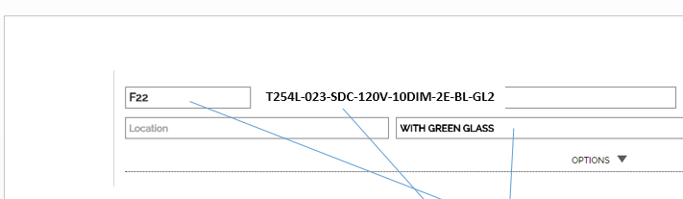
1.Create zip file with “Project Name”
2.Ask user to save in folder (chosen by user)
3.Zip file consist of single pdfs (per each product)
4. Add check box for user to chose if header will be or will not be added (we will use this functionality in a future for different membership levels)
5. Add header to each pdf page. Include information as it shown on next pages.
6. Add popup screen
6. Add title page(file) just show project name in the middle of the page. Design will follow up.
7. Add pdf file showing list of printed products (see example)
8. Progress pop up that can be minimized
9. No restrictions on consequent prints.
10. If not downloaded, remove temp file from server in 24 hours.
PDF naming:
underscore
Manufacturer’s name
Original pdf name by manufacturer
F22_T254L_Juno Lighting_manufspecname.pdf
First group of letters before (“-”, “/”, “ “, “.”, “,”)
Product spec sheet
Status
F22_T254L_Juno Lighting_manufspecname.pdf
OK
F23_ab25L_ERCO_manufspecname.pdf
-
F24_789_Amerlux_manufspecname.pdf
OK

Slide 2
One page
Project Name
Project Name _11/11/2000.pdf
Print Status
Print Status _11/11/2000.pdf
One or multiple pages

Slide 3
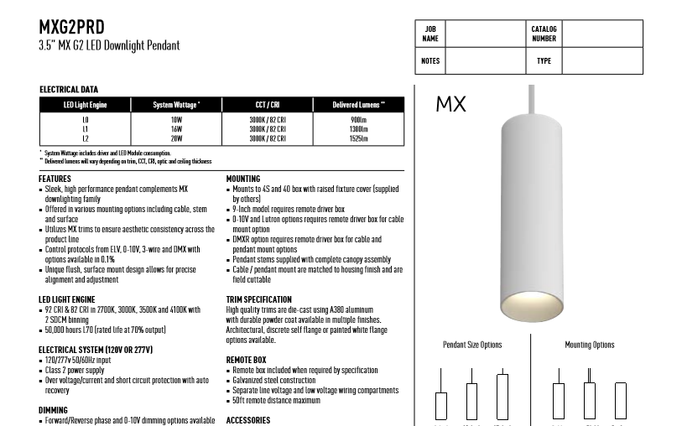
Tag (right aligned)
See next page
Have additional white header, by shrinking original pdf
F22
page edges. Same for printer and pdf
“H”

Slide 4
T254L-023-SDC-120V-10DIM-2E-BL-GL2
User’s company logo, info
Company Name
Address,
City, State, Zip
Phone
email
Project Name
F22
T254L-023-SDC-120V-10DIM-2E-BL-GL2
with green glass

