Slide 1
Search by typing
Search by typing and dropdown
PDF date
URL date
Catalog/Media date
SAVE
View/Edit
FAMILIES
Add New
Manufacturer
Family Search
Sort
Family without Product
image
PDF
URL
Media
Status
Qstns
Family
SKU
Database
Active LightAZ
Posted
Featured
Edit
Archive
Apr 02, 2017
sep 02, 2018
sep 02, 2018
Nov09, 2018
Nov09, 2018
Nov09, 2018
Nov09, 2018
Nov09, 2018
Nov09, 2018
Nov09, 2018
Nov09, 2018
Show all images
op
op
op
op
op
op
op
op
op
Apr 02, 2017
Apr 02, 2017
Nov09, 2018
Nov09, 2018
Nov09, 2018
Nov09, 2018
Nov09, 2018
Nov09, 2018
Nov09, 2018
op
op
op
op
op
op
op
op
Link to open Family page
Check box
!
?
Apr 02, 2017
Apr 02, 2017
Nov29, 2018
Nov09, 2018
Nov09, 2018
Nov09, 2018
Nov09, 2018
Nov09, 2018
op
op
op
op
op
op
Show missing image, if no actual
?
Apr 02, 2017
Apr 02, 2017
Nov09, 2018
Nov09, 2018
Nov09, 2018
Nov09, 2018
Nov09, 2018
Nov09, 2018
op
op
op
op
op
op
Archive
Icons
Check boxes
Dec 09, 2018
Nov09, 2018
Nov09, 2018
Nov09, 2018
Dec 09, 2018
Dec 09, 2018
Nov09, 2018
Nov09, 2018
Dec 09, 2018
Questions to mnf.
mj
op
op
op
mj
mj
op
mj
Shows warning if either manufacturer or QA comments added. Show Date of most recent update.
Add note to the Family page on main website: “Product is being updated”
Date and employee
Auto update when archived

Slide 2
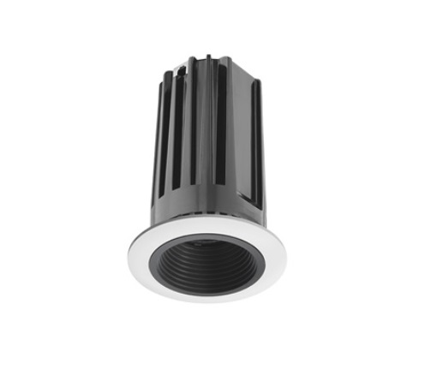
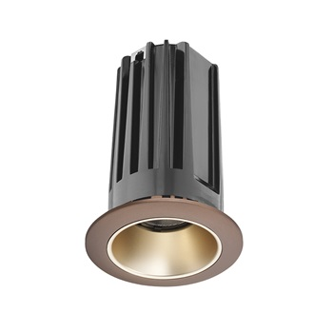
FAMILY
View
STATUS
In Progress
In Progress
MANUFACTURER. 23ED
Family*
SKU*
Database*
Back
Correct
Incorrect
Discon
Updated
Image
Links
Data
Comments
Status on LightAZ
MNF
Change PDF, A linear pendant luminaire available in continuous lengths or individual
QA
Duplicate Product
Internal Comments
Questions to Manufacturer
3?
2.Is this available with cable?
Focal Point comment
Family
SKU
Data
Access to different tabs and status dropdowns depends on security level of employee
Active
Family Code*
Family Group
Family Name*
23ED
ED
23ED. 2” Downlight
Description*
H
Text
H
Text
Text
T
Thumbnail/First Image*
Description
A linear pendant luminaire available in continuous lengths or individual units. Featuring a 2" extruded aluminum profile and a highly efficient frosted lens which provides even illumination in flush and drop lens options.
Image
Electrical
A linear pendant luminaire available in continuous lengths or individual units. Featuring a 2" extruded aluminum profile and a highly efficient frosted lens which provides even illumination in flush and drop lens options.
Image
Manufacturer Page URL*
URL Date (auto)
Manufacturer Spec URL (or type X)*
PDF Date*
Revit Files*
__/__/__
SAVE

Slide 3
Back
FAMILY
View
STATUS
In Progress
In Progress
MANUFACTURER. 23ED
Family*
SKU*
Database*
Duplicate Product
Correct
Incorrect
Discon
Updated
Image
Links
Data
Comments
Status on LightAZ
MNF
Change PDF, A linear pendant luminaire available in continuous lengths or individual
QA
Internal Comments
Questions to Manufacturer
3?
2.Is this available with cable?
Focal Point comment
Family
SKU
Data
0
)

Slide 4
Back
FAMILY
View
STATUS
In Progress
In Progress
MANUFACTURER. 23ED
Family*
SKU*
Database*
Duplicate Product
Correct
Incorrect
Discon
Updated
Image
Links
Data
Comments
Status on LightAZ
MNF
Change PDF, A linear pendant luminaire available in continuous lengths or individual
QA
Internal Comments
Questions to Manufacturer
3?
2.Is this available with cable?
Focal Point comment
Family
SKU
Data
0
0
Option Header
Option Header
Option Header
Option Header
Lumen Output
Lumen Output
Lumen Output
Lumen Output
SKU
Description
SKU
Description
SKU
Description
SKU
Description
2000L
2000 Lumens
2000L
2000 Lumens
2000L
2000 Lumens
2000L
2000 Lumens
…
T
…
T
…
…
Notes
Notes
Dimming (Not available with 500L.
Lutron 5-Series EcoSystem (LDE5) - 5% Dimming (Not available with 500L)
Lutron 5-Series EcoSystem (LDE5) - 5% Dimming (Not available with 500L)

Slide 5
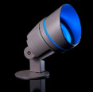
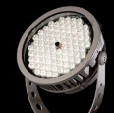
FAMILY
View
STATUS
In Progress
In Progress
Done
MANUFACTURER. 23ED
Family*
SKU*
Database*
Back
Correct
Incorrect
Discon
Updated
Image
Links
Data
Comments
Status on LightAZ
MNF
Change PDF, A linear pendant luminaire available in continuous lengths or individual
QA
Duplicate Product
Internal Comments
Questions to Manufacturer
3?
2.Is this available with cable?
Focal Point comment
Family
SKU
Data
0
3
0
Control System & Dimming Level
x
x
x
LUMENS
DIMMING
SYSTEM
Option Header
0-10V - 1% Dimming
0-10V - 1% Dimming
Lumen Output
500L
L11
L11
0-10V - 1% Dimming
SKU
Description
600L
0-10V - 10% Dimming
LD1
0-10V - 10% Dimming
LD1
0-10V - 10% Dimming
2000L
2000 Lumens
700L
Lutron Hi-Lume EcoSystem (LDE1) - 1% Dimming (Not available with 500L)
LH1
Lutron Hi-Lume EcoSystem (LDE1) - 1% Dimming (Not available with 500L)
2000L
2000 Lumens
800L
Lutron 5-Series EcoSystem (LDE5) - 5% Dimming (Not available with 500L)
LU5
Lutron 5-Series EcoSystem (LDE5) - 5% Dimming (Not available with 500L)
Not Available with
+
L11
0-10V - 1% Dimming
L11,LU5,LD1
LD1
0-10V - 10% Dimming
Available only with
+
L11
0-10V - 1% Dimming
LU5
LD1
0-10V - 10% Dimming
2000L
2000 Lumens
L11
0-10V - 1% Dimming
…
…
…
LD1
0-10V - 10% Dimming
…
Dimming (Not available with 500L.
Lutron 5-Series EcoSystem (LDE5) - 5% Dimming (Not available with 500L)
Lutron 5-Series EcoSystem (LDE5) - 5% Dimming (Not available with 500L)
Notes
Notes
2
Housing
x
CONTROLS
Not Available with
+
Available only with
+
LUMENS
DIMMING
2000L
2000 Lumens
…
Dimming (Not available with 500L.
Lutron 5-Series EcoSystem (LDE5) - 5% Dimming (Not available with 500L)
Lutron 5-Series EcoSystem (LDE5) - 5% Dimming (Not available with 500L)

Slide 6
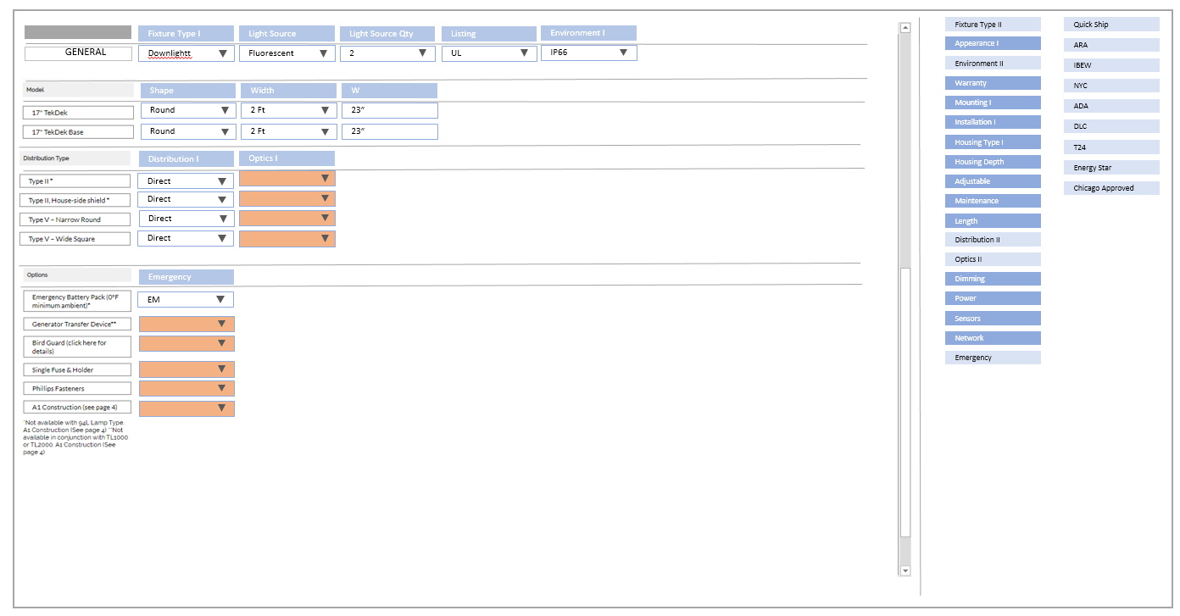
FAMILY
View
STATUS
In Progress
In Progress
Done
Done
MANUFACTURER. 23ED
Family*
SKU*
Database*
Back
Correct
Incorrect
Discon
Updated
Image
Links
Data
Comments
Status on LightAZ
MNF
Change PDF, A linear pendant luminaire available in continuous lengths or individual
QA
Duplicate Product
Internal Comments
Questions to Manufacturer
3?
2.Is this available with cable?
Focal Point comment
Family
SKU
Data
Groups
SKU
Database
Drag & Drop
Database Fields

Slide 7
When click save, highlight boxes that does not have data in required fields
FAMILY
Auto add manufacturer Code in front of Family Group
Active
Featured
Family Code
Family Group
Family Name
Auto add manufacturer Code in front of Family Code (as it is now)
Family Code. Family short name
Auto add time when link is added
Manufacturer Page URL*
URL Date (auto)
Manufacturer Spec URL (or type X)*
PDF Date*
Disable entry if X typed in the Spec URL field
__/__/__
Paste Spec link or type X if manufacturer does not have link or have multiple PDF links

Slide 8
Save and update frontend & database
SAVE
FAMILY
STATUS
In progress
Done
Manufacturer
Missing link and picture
Family*
SKU*
Database*
Blank- (not selected)
Yellow – “In progress “
Green –”Ready”
Red –”Issue”
Product can be saved at any stage
Add time of saving and user for each.
Select manufacturer by typing in, or dropdown
(required fields)
External Status, initiated by either manufacturer, user or QA
Blank – when all blank
Yellow – “In progress” when one or more of 3 is not green.
Green –”Ok” when all others are green.
Red – “Issue” if marked by commenter. Hoover over to see comment from commenter

Slide 9
Create preset CSS styles that are controllable from CSS file.
User will type and select text, than click on type to apply styling
Description
H
Text
H
Text
Text
T
Header 1
Body text
Subtext
Bullet points (same size as Body text)
Header 2
subscript

Slide 10
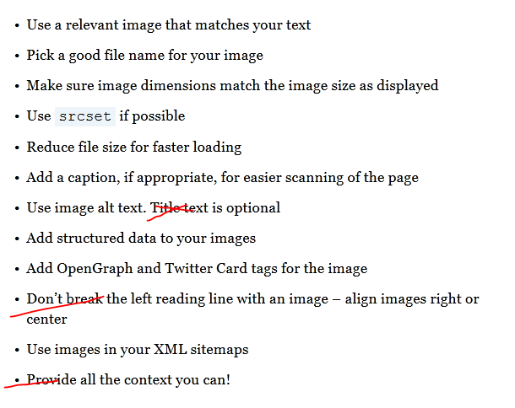
Copy and Paste image from websites or snapshots.
White & Black background choices, Zoom command , and Preset Frames 1: 800 x 500, 2: 800 x 800 3: 500 x 800
create thumbnail and first large image
Thumbnail:
-resize
-auto generate name:
“Manufacturer-Family name_01.jpg”
-auto generate alternative text
“Manufacturer. Family name”
3. Large images:
-auto generate name:
“Manufacturer-Family name_01.jpg”
“Manufacturer-Family name_02.jpg”
“Manufacturer-Family name_03.jpg”
-auto generate alternative text
“Manufacturer. Family name”
Thumbnail/First Image*
Image
Image
Image SEO
Revit Files*
Yes/No (required field)

Slide 11
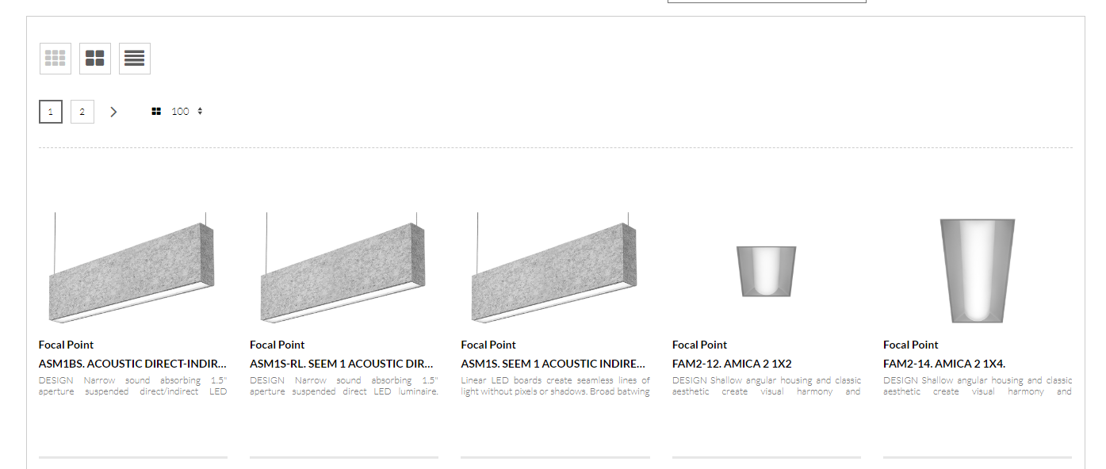
MNF DASHBOARD
Add New Product
Link to new product on your website
SUBMIT
Correct
Incorrect
Fixed
Questions
Sort By
?
3?
1?

Slide 12
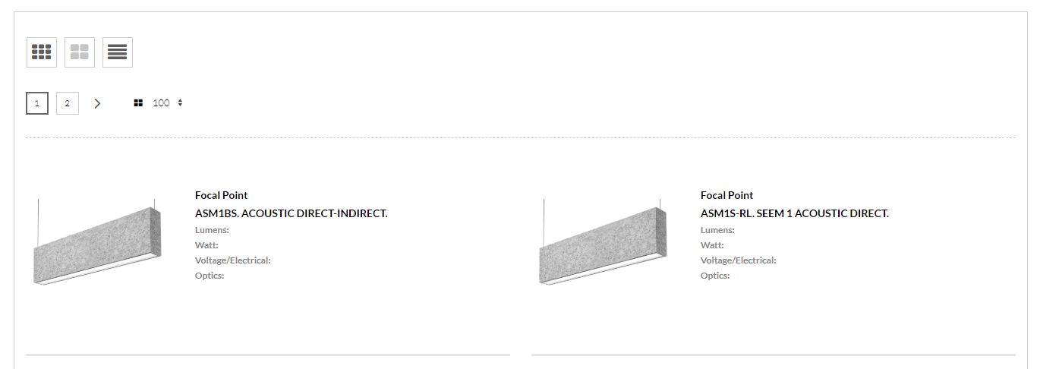
MNF DASHBOARD
Add New Product
Link to new product on your website
SUBMIT
Correct
Incorrect
Fixed
Questions
Sort By
?
3 Product questions from LightAZ
3?

Slide 13
MNF DASHBOARD
Add New Product
Link to new product on your website
SUBMIT
Correct
Incorrect
Fixed
Questions
Sort By
?
3 Product questions from LightAZ
3?

Slide 14
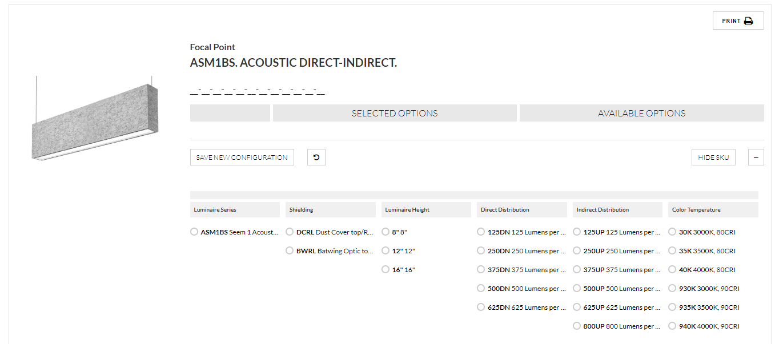
MNF DASHBOARD
Manufacturers’ comments. Please select
Correct
Incorrect
!

Slide 15
MNF DASHBOARD
When selected, activates options (next page)
Correct
Incorrect
3 Product questions from LightAZ
!
3?
Manufacturers’ comments.
Please select

Slide 16
MNF DASHBOARD
Correct
Incorrect
Discon
Updated
Image
Links
Data
Comments
Deactivate on LightAZ
Manufacturers’ comments.
Please click to select incorrect category.

Slide 17
MNF DASHBOARD
Keep record of selections and comments. Records to be “Saved” when LZ team activates all “greens”. When it occurred, change red to green (see next page)
Display one question at the time, with “answer field” below. Change numbers as answers are entered (switch to another question or “lost focus”
3.Is this downlight?
3 Answers
When selected, automatically deactivate from LightAZ. Keep active on Data
Yes
Correct
Incorrect
Discon
Updated
Image
Links
Data
Comments
Click to activate on LightAZ
3 Product questions from LightAZ
2.Is this available with cable?
3?
Manufacturers’ comments.
Please click to select incorrect category.
Focal Point comment

Slide 18
MNF DASHBOARD
Correct
Incorrect
Selecting “Correct” will return all buttons to grey and will collapse “options”
!
Manufacturers’ comments.
Please select
Mnfr to activate manually (will change to grey
Mnfr can click on grey or green to make it red again
Correct
Incorrect
Discon
Updated
Image
Links
Data
Comments
Active on LightAZ
3 Product questions from LightAZ
2.Is this available with cable?
3?
Manufacturers’ comments.
Please click to select incorrect category.
Focal Point comment

Slide 19
DATA WEBSITE
!
?

Slide 20
DATA WEBSITE
Manufacturers options- view only
View/Read only
Correct
Incorrect
Image
Links
Data
Product
Comments
Deactivate on LightAZ
3 Product questions from LightAZ
Missing link
2.Is this available with cable?
3?
Manufacturers’ comments.
Focal Point comment
QA comments.
QA options- editable

