Slide 1
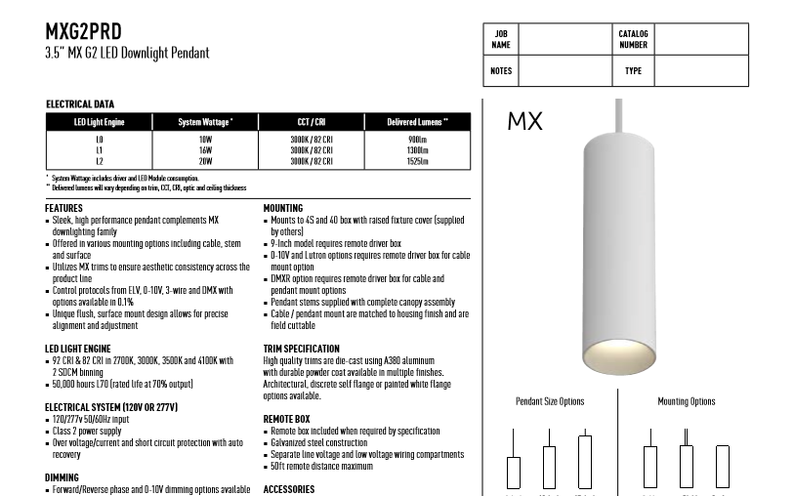
Tag (right aligned)
See next page
Have additional white header, by shrinking original pdf
F22
page edges. Same for printer and pdf
“H”

Slide 2
T254L-023-SDC-120V-10DIM-2E-BL-GL2
company logo, info
Company Name
Address,
City, State, Zip
Phone
email
Project Name
F22
T254L-023-SDC-120V-10DIM-2E-BL-GL2
with green glass

