Slide 1
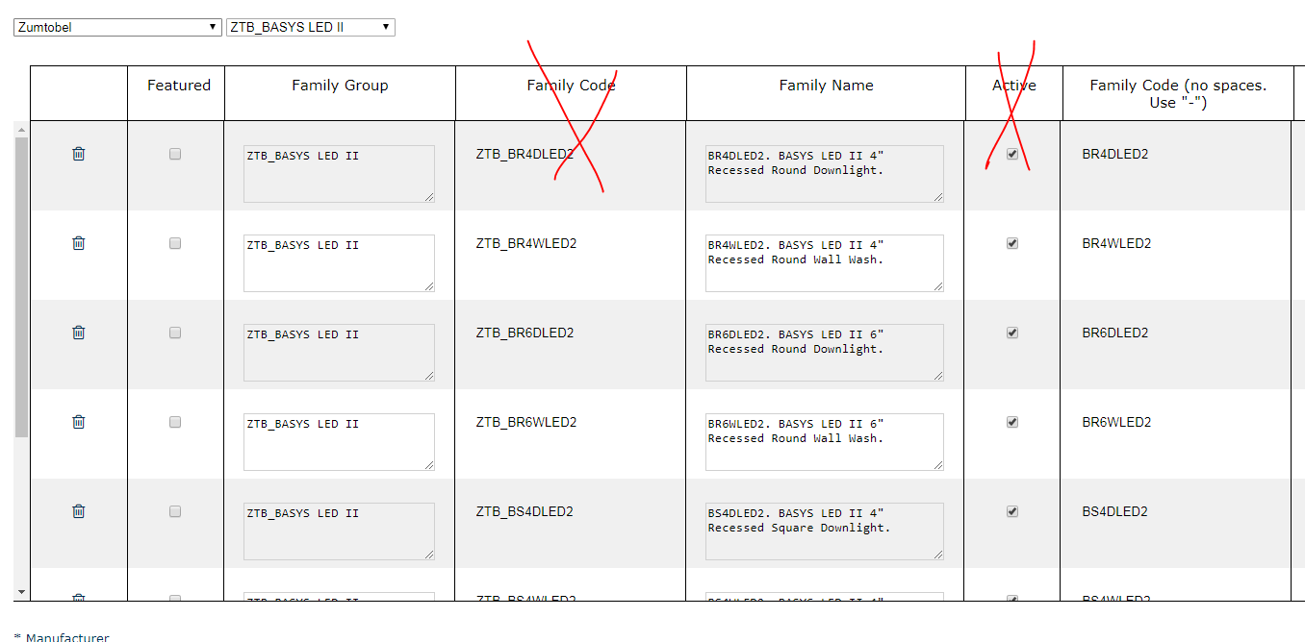
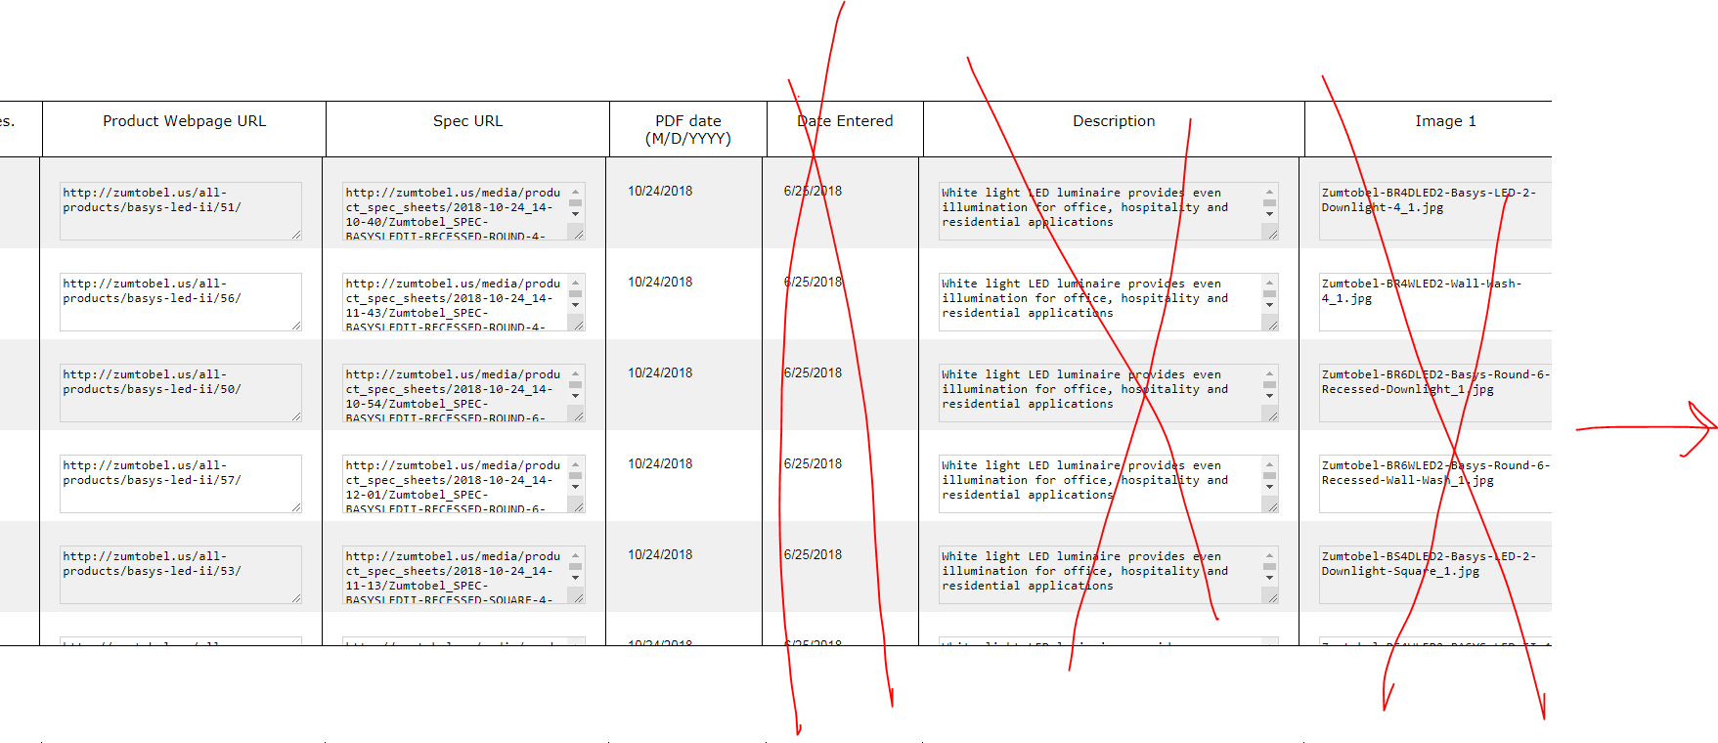

Slide 2
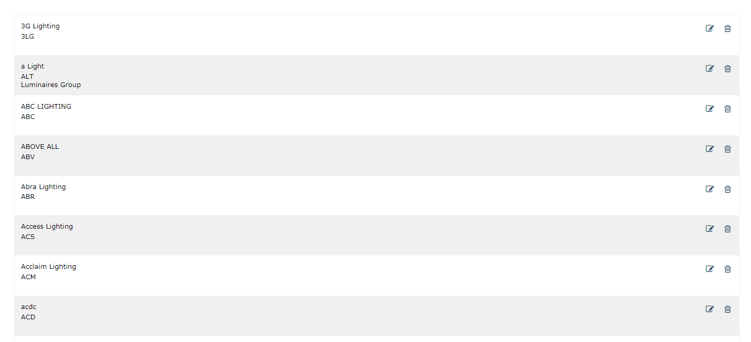
Manufacturers page
Sum of numbers
3800
4220
20/ 4380
4380
4380
20
4380
4380
5250
4900
5250
Status
Active LightAZ
Preview
Mnf Comments
Ready
/QA
Data
Mnf exists, no families
5
Added 5 families, ready for LINK CHECK schedule
As soon as we have families created in data, show links in blue
Apr 02, 2017
Apr 02, 2017
Apr 02, 2017
Apr 02, 2017
Apr 02, 2017
sep 02, 2018
Continuous process of adding fam. System tracks links as soon as schedule setup
35
5/2/19
5
35
35
1 Week
When previous columns become green, the next column become blue. First column for blue will be QA
Apr 02, 2017
Apr 02, 2017
Apr 02, 2017
Apr 02, 2017
234
Apr 02, 2017
sep 02, 2018
5/2/19
ready for QA- become blue and Data become green when Ready selected for all fam (on Family page).
234
234
234
234
1 Week
Apr 02, 2017
Apr 02, 2017
Apr 02, 2017
Apr 02, 2017
Apr 02, 2017
sep 02, 2018
QA in process
71
234
234
234
5/2/19
Apr 02, 2017
Apr 02, 2017
Apr 02, 2017
234
234
Apr 02, 2017
sep 02, 2018
1 Week
Apr 02, 2017
234
QA done (when all families checked), ready for manuf
234
234
234
5/2/19
Apr 02, 2017
Apr 02, 2017
Apr 02, 2017
234
234
Apr 02, 2017
sep 02, 2018
1 Week
35
Apr 02, 2017
234
Data moved to Manuf, waiting on comments
234
234
234
234
5/2/19
Apr 02, 2017
Apr 02, 2017
Apr 02, 2017
234
234
Apr 02, 2017
sep 02, 2018
1 Week
234
Apr 02, 2017
234
Mnf approved, ready for preview
234
234
234
234
5/2/19
Apr 02, 2017
Apr 02, 2017
Apr 02, 2017
234
234
Apr 02, 2017
sep 02, 2018
1 Week
234
Apr 02, 2017
Moved to preview
234
234
234
234
234
234
5/2/19
Apr 02, 2017
Apr 02, 2017
Apr 02, 2017
234
234
Apr 02, 2017
sep 02, 2018
1 Week
234
Apr 02, 2017
Activated on LightAZ
234
234
234
234
234
234
234
5/2/19
Apr 02, 2017
Apr 02, 2017
Apr 02, 2017
234
234
Apr 02, 2017
sep 02, 2018
1 Week
Apr 02, 2017

Slide 3
Manufacturers page
Sum of numbers
3800
4220
20/ 4380
4380
4380
20
4380
4380
5250
4900
5250
Status
Active LightAZ
Preview
Mnf Comments
Ready
/QA
Data
Mnf exists, no families
5
Added 5 families, NO LINKS
Apr 02, 2017
Apr 02, 2017
Apr 02, 2017
Apr 02, 2017
Apr 02, 2017
sep 02, 2018
5
3
3
Added Links to 3 families
Apr 02, 2017
Apr 02, 2017
Apr 02, 2017
Apr 02, 2017
6
24
Apr 02, 2017
sep 02, 2018
6 families complete (green)
10
10
Apr 02, 2017
Apr 02, 2017
Apr 02, 2017
Apr 02, 2017
6
24
Apr 02, 2017
sep 02, 2018
10
10
Links check activated and all “OK”c
Apr 02, 2017
Apr 02, 2017
Apr 02, 2017
Apr 02, 2017
sep 02, 2018
Links check activated and all “OK”c
Apr 02, 2017
5/3
24
4
10
2
10
Links check found errors,
“5” - families affected (one broken link and spec belong to same family. 4+2 - 1=5)
5/4
124
4 – shows only green. Due to 2 families out of 6 “green” families being affected
Total #
Apr 02, 2017
Apr 02, 2017
Apr 02, 2017
Apr 02, 2017
Apr 02, 2017
sep 02, 2018
83
125
125
125
Apr 02, 2017
Apr 02, 2017
Apr 02, 2017
Apr 02, 2017
Apr 02, 2017
sep 02, 2018
When top # and buttom # matched, become green, makes QA blue and ads number.
Bottom # in QA = top (green) families in data.
125
125
125
125
125
125
125
125
Apr 02, 2017
Apr 02, 2017
Apr 02, 2017
Apr 02, 2017
Apr 02, 2017
sep 02, 2018
Checked families (show “0” if non)
3/0
122
3/122
125
3
125
3/122
125
Once QA is activated, keep it active, add #
# in blue = of green families from data
Errors (accumulative/auto)
3/0
122
Apr 02, 2017
125
3/0
122
# of green families from data
Apr 02, 2017
Apr 02, 2017
Apr 02, 2017
Apr 02, 2017
sep 02, 2018
3/26
122
3/122
125
3
125
125
Apr 02, 2017
Apr 02, 2017
Apr 02, 2017
Apr 02, 2017
Apr 02, 2017
sep 02, 2018
3/122
122
3/122
125
3
125
125
Apr 02, 2017
Apr 02, 2017
Apr 02, 2017
Apr 02, 2017
Apr 02, 2017
sep 02, 2018
Errors fixed in data, but QA must finish checking
122
125
125
125
125
125
122
125
Apr 02, 2017
Apr 02, 2017
Apr 02, 2017
Apr 02, 2017
Apr 02, 2017
sep 02, 2018
0
125
125
125
125
125
125
0
All done ready to be moved to Mnf QA. Show “0”
Apr 02, 2017
Apr 02, 2017
Apr 02, 2017
Apr 02, 2017
Apr 02, 2017
sep 02, 2018
0
125
# of families checked “OK” by Mnf, show “0” if none.
0
125
125
125
125
125
125
125
moved to Mnf QA. Become yellow
# of families moved
Apr 02, 2017
Apr 02, 2017
Apr 02, 2017
Apr 02, 2017
Apr 02, 2017
sep 02, 2018

Slide 4
Manufacturers page
3800
4220
20/ 4380
4380
4380
20
4380
4380
5250
4900
5250
Status
Active LightAZ
Preview
Mnf Comments
Ready
/QA
Data
37
125
125
125
125
125
125
125
# of errors
Apr 02, 2017
Apr 02, 2017
Apr 02, 2017
Apr 02, 2017
Apr 02, 2017
sep 02, 2018
Mnf. QA # are not affected, color changed
# of families checked( “OK” & “with errors”)
37
125
5/125
120
5/120
125
125
125
5/116
103
# of green families from data
Apr 02, 2017
Apr 02, 2017
Apr 02, 2017
Apr 02, 2017
Apr 02, 2017
sep 02, 2018
Mnf. QA # are not affected, color changed
37
125
5/116
103
22/103
125
16
125
8
125
Apr 02, 2017
Apr 02, 2017
Apr 02, 2017
Apr 02, 2017
Apr 02, 2017
sep 02, 2018
Example
QA checked – 125
----------
Brocken links – 8
Error spec – 16
Mnf QA error fam – 5
Subtotal Error fam - 22 (assuming 7 is overlapping errors)
---------
Result – 125 – 22 = 103
Mnf QA
QA
# of errors found by Mnf QA
# of checked fam
inl “ok” and “error”
# of errors found by QA
= # (QA total checked fam, incl. “OK” & “Error”) - # of erroneous fam. collected from Mnf QA and Links
5/37
125
5/125
103
7
7
# total fam from data
Example
DATA has 7 “green” fam
QA checked families ABC1, ABC2, ABC3, ABC4 = 4
QA found 1 error: ABC1
----------
Then:
Brocken links – ABC2, ABC4,ABC6, ABC7
Mnf QA error fam – ABC2, ABC1
---------
Result to show: ABC3 = 1
7
7
7
1/4
7
1/6
7
# total “Green” fam from data
1/7
7
1/6
7
Data
7
Accumultive error # from Mnf QA, QA, Brocken links
7
1/7
7
7
7
22/103
125
0/1
2
# total fam
= (#total - #accumulative errors)

Slide 5
3800
4220
20/ 4380
4380
4380
20
4380
4380
5250
4900
5250
Status
Active LightAZ
Preview
Mnf Comments
Ready
/QA
Data
20
5
5
20
10
10
70
70
120
190
190
errors #
67
6 /67
120
5
190
3
190
total
240
240
240
240
240
errors #/green fam. #, (auto correct green)*
20/ 220
240
10
240
15
240
total
220
240
240
240
240
240
20
240
240
240
240
240
errors #/checked “OK” # (auto correct green)*
5/ 50
235
5 / 235
240
240
240
total
20/ 220
220
20 /220
240
240
240
20/ 220
240
240
240
240
240
240
240
240
240
240
240
240
errors #/checked “OK” #
2/ 20
240
2/ 238
240
2/ 238
240
total
240
240
2/ 20
240
5/ 235
240
5 / 235
240
240
240
2/ 50
240
22/ 218
240
22 /218
240
15
240
10
240
240
240
240
240
240
240
240
240
240
240
5/ 235
240
5/ 235
240
5/ 235
240
5/235
240
5/235
240
240
240
9/ 231
240
9/ 231
240
5/ 235
240
9/231
240
9/231
240
15
240
240
errors #/auto “green” #
total

Slide 6
Manufacturers page
3800
4220
4380
5250
4900
5250
Status
Active LightAZ
Preview
Mnf Comments
Ready
/QA
Data
35
5
120
5/2/19
Broken links
120
Apr 02, 2017
234
1 Week
Apr 02, 2017
Apr 02, 2017
Apr 02, 2017
15 / 229
15/229
15/229
234
sep 02, 2018
5/2/19
Broken links
234
234
234
1 Week
Apr 02, 2017
Apr 02, 2017
Apr 02, 2017
Apr 02, 2017
Apr 02, 2017
sep 02, 2018
3/71
234
15/229
15/229
234
5/2/19
Broken links
234
234
234
234
1 Week
Apr 02, 2017
Apr 02, 2017
Apr 02, 2017
Apr 02, 2017
Apr 02, 2017
Apr 02, 2017
sep 02, 2018
15 / 219
234
15/229
15/229
15/229
15 /229
234
234
5/2/19
Broken links
Apr 02, 2017
234
234
234
Apr 02, 2017
sep 02, 2018
1 Week
15 / 219
234
15 / 219
234
15 / 219
234
Apr 02, 2017
Apr 02, 2017
Apr 02, 2017
15 / 219
234
15 / 219
234
Broken links when on LightAZ
15/229
15/229
15/229
5/2/19
Apr 02, 2017
234
234
234
Apr 02, 2017
sep 02, 2018
1 Week
Apr 02, 2017
Apr 02, 2017
Apr 02, 2017
Apr 02, 2017
28 / 214
234
28/214
28/214
28/214
28/214
28/214
15 / 219
234
15 / 219
234
5/2/19
Broken links when on LightAZ
234
234
234
234
234
Apr 02, 2017
sep 02, 2018
1 Week
Apr 02, 2017
Apr 02, 2017
Apr 02, 2017

Slide 7
Manufacturers page
3800
4220
4380
5250
4900
5250
Status
Active LightAZ
Preview
Mnf Comments
Ready
/QA
Data
35
5
120
5/2/19
Broken links
120
Apr 02, 2017
234
1 Week
Apr 02, 2017
Apr 02, 2017
Apr 02, 2017
15 / 229
15/229
15/229
234
sep 02, 2018
5/2/19
Broken links
234
234
234
1 Week
Apr 02, 2017
Apr 02, 2017
Apr 02, 2017
Apr 02, 2017
Apr 02, 2017
sep 02, 2018
3/71
234
15/229
15/229
234
5/2/19
Broken links
234
234
234
234
1 Week
Apr 02, 2017
Apr 02, 2017
Apr 02, 2017
Apr 02, 2017
Apr 02, 2017
Apr 02, 2017
sep 02, 2018
15 / 219
234
15/229
15/229
15/229
15 /229
234
234
5/2/19
Broken links
Apr 02, 2017
234
234
234
Apr 02, 2017
sep 02, 2018
1 Week
15 / 219
234
15 / 219
234
15 / 219
234
Apr 02, 2017
Apr 02, 2017
Apr 02, 2017
15 / 219
234
15 / 219
234
Broken links when on LightAZ
15/229
15/229
15/229
5/2/19
Apr 02, 2017
234
234
234
Apr 02, 2017
sep 02, 2018
1 Week
Apr 02, 2017
Apr 02, 2017
Apr 02, 2017
Apr 02, 2017
28 / 214
234
28/214
28/214
28/214
28/214
28/214
15 / 219
234
15 / 219
234
5/2/19
Broken links when on LightAZ
234
234
234
234
234
Apr 02, 2017
sep 02, 2018
1 Week
Apr 02, 2017
Apr 02, 2017
Apr 02, 2017

Slide 8
Manufacturers page
3800
4220
4380
5250
4900
5250
Status
Active LightAZ
Preview
Mnf Comments
Ready
/QA
Data
8 / 71
8 / 222
234
234
5/2/19
Apr 02, 2017
Apr 02, 2017
Apr 02, 2017
234
234
234
234
1 Week
Comments from QA, ongoing
Apr 02, 2017
Apr 02, 2017
5/2/19
8 / 222
8 /222
234
234
1 Week
Comments from QA and all fam. checked
Apr 02, 2017
Apr 02, 2017
Apr 02, 2017
234
234
234
234
8 / 71
234
Apr 02, 2017
Apr 02, 2017
234
8/222
234
234
5/2/19
Comments from Mnf, ongoing,
Apr 02, 2017
Apr 02, 2017
234
Apr 02, 2017
234
234
234
1 Week
Apr 02, 2017
Apr 02, 2017
Apr 02, 2017
Comments from Mnf and all fam checked
12 / 222
234
234
234
234
5/2/19
Apr 02, 2017
Apr 02, 2017
234
234
234
234
234
1 Week
Apr 02, 2017
Apr 02, 2017
Apr 02, 2017
Comments from Mnf when on LightAZ
234
234
12 / 222
12 /222
12 /222
234
234
5/2/19
Apr 02, 2017
234
234
234
234
234
1 Week
Apr 02, 2017
Apr 02, 2017
Apr 02, 2017
Apr 02, 2017
sep 02, 2018
Comments from QA when on LightAZ
12 / 222
12 / 222
12 / 222
12 / 222
12 /222
234
234
5/2/19
234
234
234
234
234
234
234
1 Week
Apr 02, 2017
Apr 02, 2017
Apr 02, 2017
Apr 02, 2017
Apr 02, 2017
sep 02, 2018

Slide 9
8 / 226
8 / 226
3 / 55
5 / 55
4 /20
2
0
234
234
234
234
214
234
234
0 /20
20
0 /20
20
0
10
0
10
0 /70
120
0
190
0
190
6 /73
120
5
190
3
190
0 / 0
240
0
240
0
240
20/ 20
240
10
240
15
240
0 / 0
240
0 / 0
240
0
240
0
240
0 / 20
240
0 / 0
240
0
240
0
240
5/ 20
240
5 / 5
240
0
240
0
240
0/ 240
240
0 / 0
240
0
240
0
240
0/ 0
240
0/ 240
240
0 / 0
240
0
240
0
240
2/ 20
240
0/ 240
240
2 / 2
240
0
240
0
240
2/ 20
240
0/ 240
240
8 / 8
240
5
240
8
240
2/ 240
240
8/ 240
240
8 / 8
240
5
240
8
240
2/ 240
240
0/ 240
240
0 / 0
240
5
240
8
240

Slide 10
Manufacturers page
3800
4220
4380
5250
4900
5250
Status
Active LightAZ
Preview
Mnf Comments
Ready
/QA
Data
35
5
120
5/2/19
Broken links
120
Apr 02, 2017
234
1 Week
Apr 02, 2017
Apr 02, 2017
Apr 02, 2017
71
234
15
234
sep 02, 2018
5/2/19
Broken links
234
234
Apr 02, 2017
234
1 Week
Apr 02, 2017
Apr 02, 2017
Apr 02, 2017
234
sep 02, 2018
71
234
234
15
234
5/2/19
Broken links
234
234
234
1 Week
Apr 02, 2017
Apr 02, 2017
Apr 02, 2017
Apr 02, 2017
234
Apr 02, 2017
sep 02, 2018
234
234
234
234
15
234
234
5/2/19
Broken links
Apr 02, 2017
Apr 02, 2017
234
234
Apr 02, 2017
sep 02, 2018
1 Week
Apr 02, 2017
15
234
5
234
234
234
234
234
234
5/2/19
Broken links when on LightAZ
Apr 02, 2017
234
234
234
Apr 02, 2017
sep 02, 2018
1 Week
Apr 02, 2017
Apr 02, 2017
Families done (ones that marked green)
Families total
Apr 02, 2017
Apr 02, 2017
Apr 02, 2017
8 / 226
234
Apr 02, 2017
sep 02, 2018
5/2/19
234
234
234
234
1 Week
Apr 02, 2017
Apr 02, 2017
Apr 02, 2017
Apr 02, 2017
sep 02, 2018
Apr 02, 2017
Apr 02, 2017
Apr 02, 2017
Apr 02, 2017
sep 02, 2018
5
234
234
234
5/2/19
71
234
234
234
1 Week
Apr 02, 2017
Apr 02, 2017
Apr 02, 2017
Apr 02, 2017
sep 02, 2018

Slide 11
Manufacturers page
3800
4220
4380
5250
4900
5250
Status
Active LightAZ
Preview
Mnf Comments
Ready
/QA
Data
35
5
120
5/2/19
Broken links
120
Apr 02, 2017
234
1 Week
Apr 02, 2017
Apr 02, 2017
Apr 02, 2017
71
234
15
234
sep 02, 2018
5/2/19
Broken links
234
234
Apr 02, 2017
234
1 Week
Apr 02, 2017
Apr 02, 2017
Apr 02, 2017
234
sep 02, 2018
71
234
234
15
234
5/2/19
Broken links
234
234
234
1 Week
Apr 02, 2017
Apr 02, 2017
Apr 02, 2017
Apr 02, 2017
234
Apr 02, 2017
sep 02, 2018
234
234
234
234
15
234
234
5/2/19
Broken links
Apr 02, 2017
Apr 02, 2017
234
234
Apr 02, 2017
sep 02, 2018
1 Week
Apr 02, 2017
15
234
5
234
234
234
234
234
234
5/2/19
Broken links when on LightAZ
Apr 02, 2017
234
234
234
Apr 02, 2017
sep 02, 2018
1 Week
Apr 02, 2017
Apr 02, 2017
Apr 02, 2017
Apr 02, 2017
Apr 02, 2017
5
234
Apr 02, 2017
sep 02, 2018
5/2/19
71
234
234
234
1 Week
Apr 02, 2017
Apr 02, 2017
Apr 02, 2017
234
Apr 02, 2017
sep 02, 2018
15
234
234
5/2/19
189
234
234
234
1 Week
Apr 02, 2017
Apr 02, 2017
Apr 02, 2017
Apr 02, 2017
234
Apr 02, 2017
sep 02, 2018
234
234
234
234
234
234
5/2/19
Apr 02, 2017
Apr 02, 2017
234
234
Apr 02, 2017
sep 02, 2018
1 Week
Apr 02, 2017
234
234
234
234
234
5/2/19
234
234
234
234
234
1 Week
Apr 02, 2017
Apr 02, 2017
Apr 02, 2017
Apr 02, 2017

Slide 12
Manufacturers page
3800
4220
4380
5250
4900
5250
Status
Active LightAZ
Preview
Mnf Comments
Ready
/QA
Data
7
Added 7 families, ready for schedule
Apr 02, 2017
Apr 02, 2017
Apr 02, 2017
Apr 02, 2017
Apr 02, 2017
sep 02, 2018
5
7
7
5/2/19
Moved 5 fam to mnf for quest
Apr 02, 2017
7
1 Week
Apr 02, 2017
Apr 02, 2017
Apr 02, 2017
Apr 02, 2017
sep 02, 2018
Preparing 5 fam for mnf preview, QA in progress
2
5
7
7
5/2/19
Apr 02, 2017
7
1 Week
Apr 02, 2017
Apr 02, 2017
Apr 02, 2017
Apr 02, 2017
sep 02, 2018
5
5
7
7
5/2/19
5 fam ready for mnf preview, QA done
Apr 02, 2017
Apr 02, 2017
Apr 02, 2017
7
1 Week
2
Apr 02, 2017
sep 02, 2018
5
5
5
7
7
5/2/19
5 fam sent for mnf preview and check
Apr 02, 2017
Apr 02, 2017
Apr 02, 2017
Apr 02, 2017
7
1 Week
5
5
5
sep 02, 2018
5
7
7
5/2/19
5 fam checked by Mnf.
Apr 02, 2017
Apr 02, 2017
Apr 02, 2017
Apr 02, 2017
7
1 Week
5
sep 02, 2018
5
5
5
5
5
7
7
5/2/19
5 fam moved to LightAZ, data entry still in progress
Apr 02, 2017
Apr 02, 2017
Apr 02, 2017
Apr 02, 2017
7
1 Week
1
sep 02, 2018
5
5
5
5
5
7
2
5/2/19
Any issues when on LightAZ, marks red
Apr 02, 2017
Apr 02, 2017
5
7
7
1 Week
Apr 02, 2017
Apr 02, 2017
sep 02, 2018
Status
Image / click for preview
Fam view
Featured
Media
LightAZ
Preview
?
Mnf.
Dash
QA
Database
SKU
Family
PDF
URL
Active
Edit
Archive
Nov09, 2018
Nov09, 2018
Nov09, 2018
Nov09, 2018
Nov09, 2018
sep 02, 2018
Nov09, 2018
Ready for internal QA
op
op

Slide 13
Edit manuf info
Large # of broken links, systems will automatically recheck in 4 hours
Click on manuf to go to Family page
Status
Active LightAZ
Preview
Mnf.
comments
QA
Data
0
0
0
5/2/19
Apr 02, 2017
Apr 02, 2017
Apr 02, 2017
Apr 02, 2017
Apr 02, 2017
Apr 02, 2017
sep 02, 2018
1 Week
120
220
220
254
120
120
RECHECK
5
Apr 02, 2017
Apr 02, 2017
Apr 02, 2017
Apr 02, 2017
Apr 02, 2017
Apr 02, 2017
sep 02, 2018
5/15/19
0
0
0
5
1 Week
Apr 02, 2017
Apr 02, 2017
Apr 02, 2017
Apr 02, 2017
Apr 02, 2017
Apr 02, 2017
sep 02, 2018
5/10/19
334
334
354
1 Week
2
Apr 02, 2017
Apr 02, 2017
Apr 02, 2017
1
Apr 02, 2017
sep 02, 2018
HOLD
354
354
354
2
5/15/19
11
Apr 02, 2017
Apr 02, 2017
Apr 02, 2017
Apr 02, 2017
sep 02, 2018
5/15/19
1354
1354
1354
1
1
10
2
4 Days
Apr 02, 2017
Apr 02, 2017
Apr 02, 2017
Apr 02, 2017
Apr 02, 2017
Apr 02, 2017
sep 02, 2018
5/15/19
1354
1354
1354
5
3
2 Days
Apr 02, 2017
Apr 02, 2017
Apr 02, 2017
Apr 02, 2017
Apr 02, 2017
Apr 02, 2017
sep 02, 2018
When # are different (between Data and Mnf, and Mnf and Preview), highlight in blue
,
Last update date
# of broken links
2
Days
1
2
3
4
5
HOLD
Days
Weeks
Next date
Click to change .
Also a status
Green – on schedule
Yellow – recheck in 4 hours (when large number of links are broken)
Red - on hold, selected manually from schedule editor
When HOLD, display day of hold action
interval
Status color and how many families has red
# of products on LightAZ, Preview, Mnf. ,Data
Sum # of products with comments from Mnf
Sum # of products with comments from QA
Priority order in colors to show in Status column when any of the boxes have different colors
8
8
234
71
234
234
Apr 02, 2017

Slide 14
Edit manuf info
Large # of broken links, systems will automatically recheck in 4 hours
Click on manuf to go to Family page
8
15
0
5/2/19
71
234
345
345
1 Week
Apr 02, 2017
Apr 02, 2017
Apr 02, 2017
234
Apr 02, 2017
sep 02, 2018
8
15
5/2/19
71
234
1 Week
Apr 02, 2017
Apr 02, 2017
Apr 02, 2017
234
Apr 02, 2017
sep 02, 2018
5
234
234
5/2/19
71
234
15
1 Week
Apr 02, 2017
Apr 02, 2017
234
Apr 02, 2017
Apr 02, 2017
sep 02, 2018
Apr 02, 2017
5
234
15
5/2/19
234
234
234
1 Week
Apr 02, 2017
Apr 02, 2017
234
Apr 02, 2017
sep 02, 2018
Apr 02, 2017
234
234
5
234
15
5/2/19
234
234
234
1 Week
Apr 02, 2017
234
Apr 02, 2017
sep 02, 2018
Apr 02, 2017
Apr 02, 2017
8
234
234
234
234
234
15
5/2/19
Apr 02, 2017
234
234
Apr 02, 2017
sep 02, 2018
1 Week
Apr 02, 2017
Apr 02, 2017
Apr 02, 2017
Apr 02, 2017
Apr 02, 2017
Apr 02, 2017
Apr 02, 2017
Apr 02, 2017
sep 02, 2018
When # are different (between Data and Mnf, and Mnf and Preview), highlight in blue
,
Last update date
# of broken links
2
Days
1
2
3
4
5
HOLD
Days
Weeks
Next date
Click to change .
Also a status
Green – on schedule
Yellow – recheck in 4 hours (when large number of links are broken)
Red - on hold, selected manually from schedule editor
When HOLD, display day of hold action
interval
Status color and how many families has red
# of products on LightAZ, Preview, Mnf. ,Data
Sum # of products with comments from Mnf
Sum # of products with comments from QA
Priority order in colors to show in Status column when any of the boxes have different colors
8
8
234
71
234
234
Apr 02, 2017

Slide 15
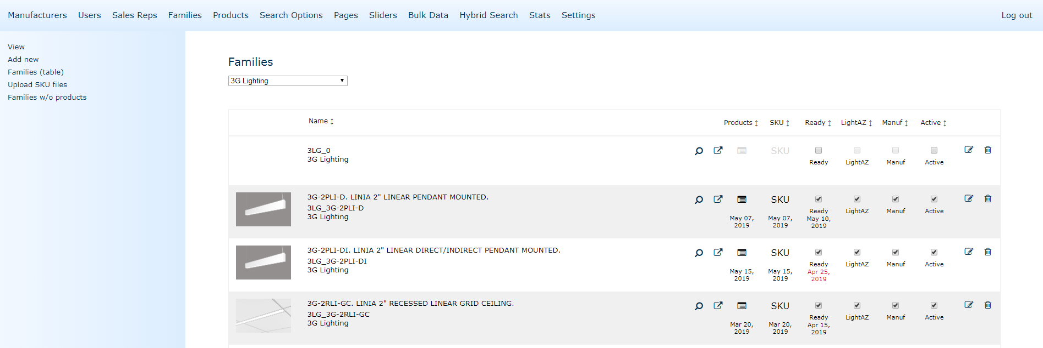
Add date
Add date when marked as wrong
Add date
Status
Image / click for preview
Fam view
Featured
Media
Active LightAZ
?
Mnf.
Dash
QA
Database
SKU
Family
PDF
URL
Active
Edit
Nov09, 2018
sep 02, 2018
Nov09, 2018
From family page
op
op
Status
Image / click for preview
Duplicate
Archive
+
Add new Family

Slide 16
Status
Image / click for preview
Fam view
Featured
Media
Active LightAZ
?
Mnf.
Dash
QA
Database
SKU
Family
PDF
URL
Active
Edit
Archive
Nov09, 2018
sep 02, 2018
Nov09, 2018
op
op
Color/Status From family page and QA/Mnf
Active LightAZ
Mnf.
Dash
QA
Active
FAMILY
View
?
Database
SKU
Family
MANUFACTURER. 23ED
Nov09, 2018
Nov09, 2018
Nov09, 2018
Nov09, 2018
Apr 02, 2017
sep 02, 2018
op
op
op
op
op
op
Manufacturer Comments/Questions
Internal QA
Correct
Image
Spec Links
Page link
Data
Discon
Updated
Hide on LightAZ
Correct
Image
Spec Links
Page link
Data
Discon
Updated
Hide on LightAZ

Slide 17
Status
Image / click for preview
Fam view
Featured
Media
Active LightAZ
?
Mnf.
Dash
QA
Database
SKU
Family
PDF
URL
Active
Edit
Archive
Nov09, 2018
sep 02, 2018
Nov09, 2018
op
op
Color/Status From family page and QA/Mnf
Active LightAZ
Mnf.
Dash
QA
Active
FAMILY
View
?
Database
SKU
Family
MANUFACTURER. 23ED
Nov09, 2018
Nov09, 2018
Nov09, 2018
Nov09, 2018
Apr 02, 2017
sep 02, 2018
op
op
op
op
op
op
Manufacturer Comments/Questions
Internal QA
Correct
Image
Spec Links
Page link
Data
Discon
Updated
Hide on LightAZ
Correct
Image
Spec Links
Page link
Data
Discon
Updated
Hide on LightAZ

Slide 18
Status
Image / click for preview
Fam view
Featured
Media
Active LightAZ
?
Mnf.
Dash
QA
Database
SKU
Family
PDF
URL
Active
Edit
Archive
Nov09, 2018
Nov09, 2018
Nov09, 2018
Nov09, 2018
Nov09, 2018
sep 02, 2018
Nov09, 2018
Ready for internal QA
op
op
Nov09, 2018
Nov09, 2018
Nov09, 2018
Nov09, 2018
Nov09, 2018
Nov09, 2018
sep 02, 2018
Nov09, 2018
QA done, Ready for mnf dashboard
op
op
Internal QA
Correct
Incorrect
!
Nov09, 2018
Nov09, 2018
Nov09, 2018
Nov09, 2018
Nov09, 2018
Nov09, 2018
Nov09, 2018
sep 02, 2018
Nov09, 2018
Manufacturer Comments/Questions
op
op
Correct
Incorrect
!
Nov09, 2018
Nov09, 2018
Nov09, 2018
Nov09, 2018
Nov09, 2018
Nov09, 2018
Nov09, 2018
sep 02, 2018
Nov09, 2018
Manufacturer Comments/Questions
op
op
Correct
Incorrect
!

Slide 19
Status
Image / click for preview
Fam view
Featured
Media
LightAZ
Preview
?
Mnf.
Dash
QA
Database
SKU
Family
PDF
URL
Active
Edit
Archive
Nov09, 2018
Nov09, 2018
Nov09, 2018
Nov09, 2018
Nov09, 2018
sep 02, 2018
Nov09, 2018
Ready for internal QA
op
op
Nov09, 2018
Nov09, 2018
Nov09, 2018
Nov09, 2018
Nov09, 2018
Nov09, 2018
sep 02, 2018
Nov09, 2018
QA done, Ready for mnf dashboard
op
op
Internal QA
Correct
Incorrect
!
Nov09, 2018
Nov09, 2018
Nov09, 2018
Nov09, 2018
Nov09, 2018
Nov09, 2018
Nov09, 2018
sep 02, 2018
Nov09, 2018
Manufacturer Comments/Questions
op
op
Correct
Incorrect
!
Nov09, 2018
Nov09, 2018
Nov09, 2018
Nov09, 2018
Nov09, 2018
Nov09, 2018
Nov09, 2018
sep 02, 2018
Nov09, 2018
Manufacturer Comments/Questions
op
op
Correct
Incorrect
!

Slide 20
Not started (default)
In progress
Done
Suggestion to next step
Problem

Slide 21
Status
Image / click for preview
Fam view
Featured
Media
Active LightAZ
?
Mnf.
Dash
QA
Database
SKU
Family
PDF
URL
Active
Edit
Archive
Nov09, 2018
Nov09, 2018
Nov09, 2018
Nov09, 2018
Nov09, 2018
sep 02, 2018
Nov09, 2018
Ready for internal QA
op
op
Nov09, 2018
Nov09, 2018
Nov09, 2018
Nov09, 2018
Nov09, 2018
Nov09, 2018
sep 02, 2018
Nov09, 2018
QA done, mistakes
op
op
Internal QA
Correct
Image
Spec Links
Page link
Data
Discon
Updated
Hide on LightAZ
Active LightAZ
Mnf.
Dash
QA
Active
FAMILY
View
?
Database
SKU
Family
MANUFACTURER. 23ED
Apr 02, 2017
Nov09, 2018
Nov09, 2018
Nov09, 2018
Apr 02, 2017
sep 02, 2018
op
op
op
op
op
op
Active LightAZ
Mnf.
Dash
QA
Active
FAMILY
View
?
Product
SKU
Family
MANUFACTURER. 23ED
Apr 02, 2017
Nov09, 2018
Nov09, 2018
Nov09, 2018
Apr 02, 2017
sep 02, 2018
op
op
op
op
op
op
Active LightAZ
Mnf.
Dash
QA
Active
FAMILY
View
?
Product
SKU
Family
MANUFACTURER. 23ED
Nov09, 2018
Nov09, 2018
Nov09, 2018
Apr 02, 2017
sep 02, 2018
op
op
op
op
op
Nov09, 2018
Nov09, 2018
Nov09, 2018
Nov09, 2018
Nov09, 2018
sep 02, 2018
Nov09, 2018
When fixed, Ready for internal QA
op
op

Slide 22
Active LightAZ
Mnf.
Dash
QA
Active
FAMILY
View
?
Product
SKU
Family
MANUFACTURER. 23ED
Nov09, 2018
Nov09, 2018
Nov09, 2018
Apr 02, 2017
sep 02, 2018
op
op
op
op
op
Manufacturer Comments/Questions
Internal QA
Correct
Image
Spec Links
Page link
Data
Discon
Updated
Hide on LightAZ
Correct
Incorrect
!
Nov09, 2018
Nov09, 2018
Nov09, 2018
Nov09, 2018
Nov09, 2018
sep 02, 2018
Nov09, 2018
When fixed, Ready for internal QA
op
op

Slide 23
Active LightAZ
Mnf.
Dash
QA
Active
FAMILY
View
?
Database
SKU
Family
MANUFACTURER. 23ED
Nov09, 2018
Nov09, 2018
Nov09, 2018
Nov09, 2018
Apr 02, 2017
sep 02, 2018
op
op
op
op
op
op
Manufacturer Comments/Questions
Correct
Image
Spec Links
Page link
Data
Discon
Updated
Hide on LightAZ
Focal Point
02/01/2019
Please change to other image.
2000 Lm should not be available with 30W
Link points to old spec
LightAZ:
02/10/2019
Should we remove product?
Active LightAZ
Mnf.
Dash
QA
Active
FAMILY
View
?
Database
SKU
Family
MANUFACTURER. 23ED
Nov09, 2018
Nov09, 2018
Nov09, 2018
Nov09, 2018
Apr 02, 2017
sep 02, 2018
op
op
op
op
op
op
Manufacturer Comments/Questions
Correct
Image
Spec Links
Page link
Data
Discon
Updated
Hide on LightAZ
Focal Point
02/01/2019
Please change to other image.
2000 Lm should not be available with 30W
Link points to old spec
LightAZ:
02/10/2019
Should we remove product?

Slide 24
Active LightAZ
Mnf.
Dash
QA
Active
FAMILY
View
?
Database
SKU
Family
MANUFACTURER. 23ED
Nov09, 2018
Apr 02, 2017
Nov09, 2018
Nov09, 2018
Nov09, 2018
Apr 02, 2017
sep 02, 2018
op
op
op
op
op
op
op
Manufacturer Comments/Questions
Correct
Image
Spec Links
Page link
Data
Discon
Updated
Hide on LightAZ
Focal Point
02/01/2019
Please change to other image.
2000 Lm should not be available with 30W
Link points to old spec
LightAZ:
02/10/2019
Should we remove product?
Correct
Image
Spec Links
Page link
Data
Discon
Updated
Hide on LightAZ
Active LightAZ
Mnf.
Dash
QA
Active
FAMILY
View
?
Product
SKU
Family
MANUFACTURER. 23ED
Nov09, 2018
Apr 02, 2017
Nov09, 2018
Nov09, 2018
Nov09, 2018
Apr 02, 2017
sep 02, 2018
op
op
op
op
op
op
op
Manufacturer Comments/Questions
Correct
Image
Spec Links
Page link
Data
Discon
Updated
Hide on LightAZ
Focal Point
02/01/2019
Please change to other image.
2000 Lm should not be available with 30W
Link points to old spec
LightAZ:
02/10/2019
Should we remove product?

Slide 25
Status
Image / click for preview
Featured
Media
Project
Product
Active LightAZ
?
Mnf.
Dash
QA
Database
SKU
Family
PDF
URL
Edit
Nov09, 2018
Nov09, 2018
op
Nov09, 2018
Apr 02, 2017
sep 02, 2018
Nov09, 2018
op
op
op
Nov09, 2018
op
Nov09, 2018
Nov09, 2018
Nov09, 2018
Apr 02, 2017
sep 02, 2018
op
op
op
op
op
Nov09, 2018
op
Nov09, 2018
Nov09, 2018
Nov09, 2018
Apr 02, 2017
sep 02, 2018
op
op
op
op
op
Nov09, 2018
op
Nov09, 2018
Nov09, 2018
Nov09, 2018
Apr 02, 2017
sep 02, 2018
op
op
op
op
op
Nov09, 2018
Apr 15, 2017
op
Nov09, 2018
Nov09, 2018
Nov09, 2018
Apr 02, 2017
sep 02, 2018
op
op
op
op
op
Nov09, 2018
Apr 15, 2017
op
Nov09, 2018
Nov09, 2018
Nov09, 2018
Nov09, 2018
Apr 02, 2017
sep 02, 2018
op
op
op
op
op
op
Nov09, 2018
op
Nov09, 2018
Nov09, 2018
Nov09, 2018
Nov09, 2018
Nov09, 2018
Apr 02, 2017
sep 02, 2018
op
op
op
op
op
op
op
Nov09, 2018
op
Nov09, 2018
Nov09, 2018
Nov09, 2018
Nov09, 2018
Nov09, 2018
Apr 02, 2017
sep 02, 2018
op
op
op
op
op
op
op
Nov09, 2018
op
Nov09, 2018
Nov09, 2018
Nov09, 2018
Nov09, 2018
Apr 02, 2017
sep 02, 2018
op
op
op
op
op
op
Nov09, 2018
op
Nov09, 2018
Nov09, 2018
Nov09, 2018
Nov09, 2018
Nov09, 2018
Apr 02, 2017
sep 02, 2018
op
op
op
op
op
op
op
Nov09, 2018
op
Nov09, 2018
Nov09, 2018
Nov09, 2018
Nov09, 2018
Nov09, 2018
Nov09, 2018
Apr 02, 2017
sep 02, 2018
op
op
op
op
op
op
op
op
Nov09, 2018
op

Slide 26
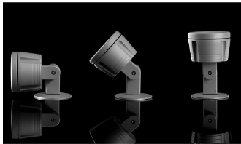
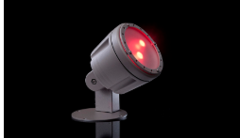
Active LightAZ
Mnf.
Dash
QA
Active
FAMILY
View
?
Database
SKU
Family
MANUFACTURER. 23ED
Nov09, 2018
Nov09, 2018
Nov09, 2018
Nov09, 2018
Apr 02, 2017
sep 02, 2018
op
op
op
op
op
op
Manufacturer Comments/Questions
Internal QA
Correct
Image
Spec Links
Page link
Data
Discon
Updated
Hide on LightAZ
Correct
Image
Spec Links
Page link
Data
Discon
Updated
Hide on LightAZ
Focal Point
02/01/2019
Please change to other image.
2000 Lm should not be available with 30W
Link points to old spec
LightAZ:
02/10/2019
Should we remove product?
Change PDF, A linear pendant luminaire available in continuous lengths or individual
Family
SKU
Data
Access to different tabs and status dropdowns depends on security level of employee
Family Code*
Family Group
Family Name*
23ED
ED
23ED. 2” Downlight
Description*
H
Text
H
Text
Text
T
Description
A linear pendant luminaire available in continuous lengths or individual units. Featuring a 2" extruded aluminum profile and a highly efficient frosted lens which provides even illumination in flush and drop lens options.
Electrical
A linear pendant luminaire available in continuous lengths or individual units. Featuring a 2" extruded aluminum profile and a highly efficient frosted lens which provides even illumination in flush and drop lens options.
Manufacturer Page URL*
URL Date (auto)
https://www.preview.lightaz.com/led-luminaire-details?f=INS_5SP-CC
03/05/19
Manufacturer Spec URL (or type X)*
PDF Date*
https://www.preview.lightaz.com/led-luminaire-details?f=INS_5SP-CC
__/__/__
Featured
Revit Files*

Slide 27
Active LightAZ
Mnf.
Dash
QA
Active
FAMILY
View
?
Database
SKU
Family
MANUFACTURER. 23ED
Nov09, 2018
Nov09, 2018
Nov09, 2018
Nov09, 2018
Apr 02, 2017
sep 02, 2018
op
op
op
op
op
op
Family Code*
Family Code*
23ED
23ED
CREATE FAMILY

Slide 28
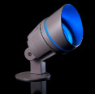
Active LightAZ
Mnf.
Dash
QA
Active
FAMILY
View
?
Database
SKU
Family
MANUFACTURER. 23ED
Progress
Ready
Ready
Ready
Nov09, 2018
Nov09, 2018
Nov09, 2018
Nov09, 2018
Apr 02, 2017
sep 02, 2018
op
op
op
op
op
op
Manufacturer Comments/Questions
Internal QA
Correct
Image
Spec Links
Page link
Data
Discon
Updated
Hide on LightAZ
Correct
Image
Spec Links
Page link
Data
Discon
Updated
Hide on LightAZ
Focal Point
02/01/2019
Please change to other image.
2000 Lm should not be available with 30W
Link points to old spec
LightAZ:
02/10/2019
Should we remove product?
Change PDF, A linear pendant luminaire available in continuous lengths or individual
Family
SKU
Data
LUMENS
LUMENS
LUMENS
LUMENS
LUMENS
700L
Lutron Hi-Lume EcoSystem (LDE1) - 1% Dimming (Not available with 500L)
700L
Lutron Hi-Lume EcoSystem (LDE1) - 1% Dimming (Not available with 500L)
700L
Lutron Hi-Lume EcoSystem (LDE1) - 1% Dimming (Not available with 500L)
700L
Lutron Hi-Lume EcoSystem (LDE1) - 1% Dimming (Not available with 500L)
SKU
Description
800L
Lutron 5-Series EcoSystem (LDE5) - 5% Dimming (Not available with 500L)
800L
Lutron 5-Series EcoSystem (LDE5) - 5% Dimming (Not available with 500L)
800L
Lutron 5-Series EcoSystem (LDE5) - 5% Dimming (Not available with 500L)
…
_ _
Custom Dimming
800L
Lutron 5-Series EcoSystem (LDE5) - 5% Dimming (Not available with 500L)
_ _
Custom Dimming
_ DL
Custom Dimming
_ _
Custom Dimming
Not Available with
_ DL
Custom Dimming
SKU
Description
_ DL
Custom Dimming
SKU
(SKU&SKU)
GROUP
SKU
Description
…
SKU
Description
…
…
Add rules
+
Available only with
Add rules
+
_ _
Custom Dimming
_ DL
Custom Dimming
SKU
Description
…

Slide 29
Active LightAZ
Mnf.
Dash
QA
Active
FAMILY
View
?
Database
SKU
Family
MANUFACTURER. 23ED
Progress
Ready
Ready
Ready
Nov09, 2018
Nov09, 2018
Nov09, 2018
Nov09, 2018
Apr 02, 2017
sep 02, 2018
op
op
op
op
op
op
Manufacturer Comments/Questions
Internal QA
Correct
Image
Spec Links
Page link
Data
Discon
Updated
Hide on LightAZ
Correct
Image
Spec Links
Page link
Data
Discon
Updated
Hide on LightAZ
Focal Point
02/01/2019
Please change to other image.
2000 Lm should not be available with 30W
Link points to old spec
LightAZ:
02/10/2019
Should we remove product?
Change PDF, A linear pendant luminaire available in continuous lengths or individual
Family
SKU
Data
LUMENS
LUMENS
LUMENS
LUMENS
LUMENS
700L
Lutron Hi-Lume EcoSystem (LDE1) - 1% Dimming (Not available with 500L)
700L
Lutron Hi-Lume EcoSystem (LDE1) - 1% Dimming (Not available with 500L)
700L
Lutron Hi-Lume EcoSystem (LDE1) - 1% Dimming (Not available with 500L)
700L
Lutron Hi-Lume EcoSystem (LDE1) - 1% Dimming (Not available with 500L)
SKU
Description
800L
Lutron 5-Series EcoSystem (LDE5) - 5% Dimming (Not available with 500L)
800L
Lutron 5-Series EcoSystem (LDE5) - 5% Dimming (Not available with 500L)
800L
Lutron 5-Series EcoSystem (LDE5) - 5% Dimming (Not available with 500L)
…
_ _
Custom Dimming
800L
Lutron 5-Series EcoSystem (LDE5) - 5% Dimming (Not available with 500L)
_ _
Custom Dimming
_ DL
Custom Dimming
_ _
Custom Dimming
Not Available with
_ DL
Custom Dimming
SKU
Description
_ DL
Custom Dimming
SKU
(SKU&SKU)
GROUP
SKU
Description
…
SKU
Description
…
…
Add rules
+
Available only with
Add rules
+
_ _
Custom Dimming
_ DL
Custom Dimming
SKU
Description
…

Slide 30
Active LightAZ
Mnf.
Dash
QA
Active
FAMILY
View
?
Database
SKU
Family
MANUFACTURER. 23ED
Progress
Ready
Ready
Ready
Nov09, 2018
Nov09, 2018
Nov09, 2018
Nov09, 2018
Apr 02, 2017
sep 02, 2018
op
op
op
op
op
op
Manufacturer Comments/Questions
Internal QA
Correct
Image
Spec Links
Page link
Data
Discon
Updated
Hide on LightAZ
Correct
Image
Spec Links
Page link
Data
Discon
Updated
Hide on LightAZ
Focal Point
02/01/2019
Please change to other image.
2000 Lm should not be available with 30W
Link points to old spec
LightAZ:
02/10/2019
Should we remove product?
Change PDF, A linear pendant luminaire available in continuous lengths or individual
Family
SKU
Data
ALL
FIXTURE SPECIFICATION GUIDE
ABC 1
3
ABC 2
2
ID
LUMENS
WATTS
+
+
SKU
Description
700L
Lutron Hi-Lume EcoSystem (LDE1) - 1% Dimming (Not available with 500L)
_ DL
Custom Dimming
Notes
800L
Lutron 5-Series EcoSystem (LDE5) - 5% Dimming (Not available with 500L)
Notes
…
Not Available with
…
WATTS
+
Available only with
+
L11,LU5,LD1
Should be selected with
+
AES
SKU
Description
Notes
1. Lutron 5-Series EcoSystem (LDE5) - 5% Dimming (Not available with 500L)
2. Lutron 5-Series EcoSystem (LDE5) - 5% Dimming (Not available with 500L)
…
+
Add header
+
+
+
+
+
Notes

Slide 31
Active LightAZ
Mnf.
Dash
QA
Active
FAMILY
View
?
Database
SKU
Family
MANUFACTURER. 23ED
Progress
Ready
Ready
Ready
Nov09, 2018
Nov09, 2018
Nov09, 2018
Nov09, 2018
Apr 02, 2017
sep 02, 2018
op
op
op
op
op
op
Manufacturer Comments/Questions
Internal QA
Correct
Image
Spec Links
Page link
Data
Discon
Updated
Hide on LightAZ
Correct
Image
Spec Links
Page link
Data
Discon
Updated
Hide on LightAZ
Focal Point
02/01/2019
Please change to other image.
2000 Lm should not be available with 30W
Link points to old spec
LightAZ:
02/10/2019
Should we remove product?
Change PDF, A linear pendant luminaire available in continuous lengths or individual
Family
SKU
Data
ALL
FIXTURE SPECIFICATION GUIDE
ABC 1
3
ABC 2
2
ID
LUMENS
WATTS
+
+
SKU
Description
700L
Lutron Hi-Lume EcoSystem (LDE1) - 1% Dimming (Not available with 500L)
_ DL
Custom Dimming
Notes
800L
Lutron 5-Series EcoSystem (LDE5) - 5% Dimming (Not available with 500L)
Notes
…
Not Available with
…
WATTS
+
Available only with
+
L11,LU5,LD1
Should be selected with
+
AES
SKU
Description
Notes
1. Lutron 5-Series EcoSystem (LDE5) - 5% Dimming (Not available with 500L)
2. Lutron 5-Series EcoSystem (LDE5) - 5% Dimming (Not available with 500L)
…
+
Add header
header
1
+
Add header
+
+
+
+
+
Notes

Slide 32
Active LightAZ
Mnf.
Dash
QA
Active
FAMILY
View
?
Database
SKU
Family
MANUFACTURER. 23ED
Progress
Ready
Ready
Ready
Nov09, 2018
Nov09, 2018
Nov09, 2018
Nov09, 2018
Apr 02, 2017
sep 02, 2018
op
op
op
op
op
op
Manufacturer Comments/Questions
Internal QA
Correct
Image
Spec Links
Page link
Data
Discon
Updated
Hide on LightAZ
Correct
Image
Spec Links
Page link
Data
Discon
Updated
Hide on LightAZ
Focal Point
02/01/2019
Please change to other image.
2000 Lm should not be available with 30W
Link points to old spec
LightAZ:
02/10/2019
Should we remove product?
Change PDF, A linear pendant luminaire available in continuous lengths or individual
Family
SKU
Data
ALL
FIXTURE SPECIFICATION GUIDE
ABC 1
3
ABC 2
2
ID
LUMENS
WATTS
+
+
SKU
Description
700L
Lutron Hi-Lume EcoSystem (LDE1) - 1% Dimming (Not available with 500L)
_ DL
Custom Dimming
Notes
800L
Lutron 5-Series EcoSystem (LDE5) - 5% Dimming (Not available with 500L)
Notes
…
Not Available with
…
WATTS
+
Available only with
+
L11,LU5,LD1
Should be selected with
+
AES
SKU
Description
Notes
1. Lutron 5-Series EcoSystem (LDE5) - 5% Dimming (Not available with 500L)
2. Lutron 5-Series EcoSystem (LDE5) - 5% Dimming (Not available with 500L)
…
+
Add header
Add header
+
Add header
Lumen
1
+
Add header
Watt
5
+
+
+
+
+
+
Notes

Slide 33
Active LightAZ
Mnf.
Dash
QA
Active
FAMILY
View
?
Database
SKU
Family
MANUFACTURER. 23ED
Progress
Ready
Ready
Ready
Nov09, 2018
Nov09, 2018
Nov09, 2018
Nov09, 2018
Apr 02, 2017
sep 02, 2018
op
op
op
op
op
op
Manufacturer Comments/Questions
Internal QA
Correct
Image
Spec Links
Page link
Data
Discon
Updated
Hide on LightAZ
Correct
Image
Spec Links
Page link
Data
Discon
Updated
Hide on LightAZ
Focal Point
02/01/2019
Please change to other image.
2000 Lm should not be available with 30W
Link points to old spec
LightAZ:
02/10/2019
Should we remove product?
Change PDF, A linear pendant luminaire available in continuous lengths or individual
Family
SKU
Data
FIXTURE
ABC 1
3
ABC 2
2
ID
LUMENS
WATTS
+
+
SKU
Description
_ DL
700L
Lutron Hi-Lume EcoSystem (LDE1) - 1% Dimming (Not available with 500L)
Custom Dimming
Notes
800L
Notes
Lutron 5-Series EcoSystem (LDE5) - 5% Dimming (Not available with 500L)
…
Not Available with
…
WATTS
+
Available only with
+
L11,LU5,LD1
Should be selected with
+
AES
SKU
Description
Notes
1. Lutron 5-Series EcoSystem (LDE5) - 5% Dimming (Not available with 500L)
2. Lutron 5-Series EcoSystem (LDE5) - 5% Dimming (Not available with 500L)
…
+
+
+
+
+
Notes

Slide 34
Active LightAZ
Mnf.
Dash
QA
Active LightAZ
FAMILY
View
?
Database
SKU
Family
MANUFACTURER. 23ED
Progress
Ready
Ready
Ready
Nov09, 2018
Nov09, 2018
Nov09, 2018
Nov09, 2018
Apr 02, 2017
sep 02, 2018
op
op
op
op
op
op
Manufacturer Comments/Questions
Internal QA
Correct
Image
Spec Links
Page link
Data
Discon
Updated
Hide on LightAZ
Correct
Image
Spec Links
Page link
Data
Discon
Updated
Hide on LightAZ
Focal Point
02/01/2019
Please change to other image.
2000 Lm should not be available with 30W
Link points to old spec
LightAZ:
02/10/2019
Should we remove product?
Change PDF, A linear pendant luminaire available in continuous lengths or individual
Family
SKU
Data
Access to different tabs and status dropdowns depends on security level of employee
LUMENS
LUMENS
LUMENS
700L
Lutron Hi-Lume EcoSystem (LDE1) - 1% Dimming (Not available with 500L)
700L
Lutron Hi-Lume EcoSystem (LDE1) - 1% Dimming (Not available with 500L)
700L
Lutron Hi-Lume EcoSystem (LDE1) - 1% Dimming (Not available with 500L)
800L
Lutron 5-Series EcoSystem (LDE5) - 5% Dimming (Not available with 500L)
800L
Lutron 5-Series EcoSystem (LDE5) - 5% Dimming (Not available with 500L)
_ _
Custom Dimming
800L
Lutron 5-Series EcoSystem (LDE5) - 5% Dimming (Not available with 500L)
_ DL
Custom Dimming
Not Available with (SKU)
SKU
Description
_ _
Custom Dimming
SKU
…
_ DL
Custom Dimming
1. When specifying this option, do not use with options:
SKU
Description
…
SKU
Notes location
Add next
+
Available only with (SKU)
SKU
Available only with
SKU
Notes location
Add next
+
_ _
Custom Dimming
_ DL
Custom Dimming
SKU
Description
…

Slide 35
Active LightAZ
Mnf.
Dash
QA
FAMILY
View
?
Database
SKU
Family
MANUFACTURER. 23ED
Progress
Ready
Ready
Ready
Nov09, 2018
Nov09, 2018
Nov09, 2018
Nov09, 2018
Apr 02, 2017
sep 02, 2018
op
op
op
op
op
op
Manufacturer Comments/Questions
Internal QA
Nov09, 2018
Correct
Image
Spec Links
Page link
Data
Discon
Updated
Hide on LightAZ
Correct
Image
Spec Links
Page link
Data
Discon
Updated
Hide on LightAZ
Focal Point
02/01/2019
Please change to other image.
2000 Lm should not be available with 30W
Link points to old spec
LightAZ:
02/10/2019
Should we remove product?
Change PDF, A linear pendant luminaire available in continuous lengths or individual
Family
SKU
Data

Slide 36
Back
FAMILY
View
STATUS
In Progress
In Progress
MANUFACTURER. 23ED
Family*
SKU*
Database*
Duplicate Product
Correct
Incorrect
Discon
Updated
Image
Links
Data
Comments
Status on LightAZ
MNF
Change PDF, A linear pendant luminaire available in continuous lengths or individual
QA
Internal Comments
Questions to Manufacturer
3?
2.Is this available with cable?
Focal Point comment
Family
SKU
Data
0
)

Slide 37
FAMILY
View
Active LightAZ
?
Mnf.
Dash
QA
?
Database
SKU
Family
MANUFACTURER. 23ED
Progress
Ready
Ready
Ready
Nov09, 2018
Nov09, 2018
Nov09, 2018
Nov09, 2018
Apr 02, 2017
sep 02, 2018
op
op
op
op
op
op
Manufacturer Comments/Questions
Internal QA
Correct
Image
Spec Links
Page link
Data
Discon
Updated
Status on LightAZ
Correct
Image
Spec Links
Page link
Data
Discon
Updated
Status on LightAZ
Focal Point
02/01/2019
Please change to other image.
2000 Lm should not be available with 30W
Link points to old spec
LightAZ:
updated 02/10/2019
Change PDF, A linear pendant luminaire available in continuous lengths or individual
Family
SKU
Data
0
0
Option Header
Option Header
Option Header
Option Header
Lumen Output
Lumen Output
Lumen Output
Lumen Output
SKU
Description
SKU
Description
SKU
Description
SKU
Description
2000L
2000 Lumens
2000L
2000 Lumens
2000L
2000 Lumens
2000L
2000 Lumens
…
T
…
T
…
…
Notes
Notes
Dimming (Not available with 500L.
Lutron 5-Series EcoSystem (LDE5) - 5% Dimming (Not available with 500L)
Lutron 5-Series EcoSystem (LDE5) - 5% Dimming (Not available with 500L)

Slide 38
Movable, drug and drop in place
LUMENS
LUMENS
LUMENS
LUMENS
SKU
Description
Single selection
Description
500 Lumens
SKU
500L
500L
500 Lumens
Single selection with custom field
Description
Option
SKU
SKU
Description
…
Option with custom field
…
Single selection
Single selection with custom field
…
Option
…
Header setting..Selects for all in card (optional), when selected will override individuals
Option with custom field
Changes individually (required).. Can’t use text field until that one is picked. Will override Header setting individually
LUMENS
700L
Lutron Hi-Lume EcoSystem (LDE1) - 1% Dimming (Not available with 500L)
LUMENS
LUMENS
LUMENS
800L
Lutron 5-Series EcoSystem (LDE5) - 5% Dimming (Not available with 500L)
SKU
Description
SKU
Description
Not Available with SKU
+
_ _
Custom Dimming
…
…
Available only with SKU
+
_ DL
Custom Dimming
T
Custom Dimming
…
SKU
Description
Adds image placeholder (drug&drop) to each record in the card
Notes
…
Adds text editor for notes per card
For custom buttons, change box to line, and add 2 underscores
Resolve if same SKU in different columns, or custom blank field
LUMENS
LUMENS
LUMENS
700L
Lutron Hi-Lume EcoSystem (LDE1) - 1% Dimming (Not available with 500L)
700L
Lutron Hi-Lume EcoSystem (LDE1) - 1% Dimming (Not available with 500L)
700L
Lutron Hi-Lume EcoSystem (LDE1) - 1% Dimming (Not available with 500L)
800L
Lutron 5-Series EcoSystem (LDE5) - 5% Dimming (Not available with 500L)
800L
Lutron 5-Series EcoSystem (LDE5) - 5% Dimming (Not available with 500L)
800L
Lutron 5-Series EcoSystem (LDE5) - 5% Dimming (Not available with 500L)
Not Available with SKU
_ _
Custom Dimming
+
Not Available with
_ DL
Custom Dimming
Available only with SKU
L11, LU5, LD1
+
Custom Dimming
+
Not Available with
+
SKU
Description
_ _
Custom Dimming
Available only with
+
…
_ DL
Custom Dimming
AES
SKU
Description
_ _
Custom Dimming
…
_ DL
Custom Dimming
SKU
Description
Can add as many as needed
…
Activate item if note says, “should be selected with”
Recognizes by name if it is SKU or GROUP
Should be validated if SKUs names exist
Non visible groups
Radio button(single selection)
Single selection
Single selection with custom field
Checkbox (multiple selections)
Option
Option with custom field
Removes record
Remove record

Slide 39
LUMENS
LUMENS
Undo, redo, subscript (upper), bold, italic, special characters, bullets/numbering
700L
Lutron Hi-Lume EcoSystem (LDE1) - 1% Dimming (Not available with 500L)
LUMENS
700L
Lutron Hi-Lume EcoSystem (LDE1) - 1% Dimming (Not available with 500L)
700L
Lutron Hi-Lume EcoSystem (LDE1) - 1% Dimming (Not available with 500L)
800L
Lutron 5-Series EcoSystem (LDE5) - 5% Dimming (Not available with 500L)
800L
Lutron 5-Series EcoSystem (LDE5) - 5% Dimming (Not available with 500L)
_ _
Custom Dimming
800L
Lutron 5-Series EcoSystem (LDE5) - 5% Dimming (Not available with 500L)
_ DL
Custom Dimming
Not Available with (SKU)
SKU
Description
_ _
Custom Dimming
SKU
…
_ DL
Custom Dimming
1. When specifying this option, do not use with options:
SKU
Description
…
SKU
Notes location
Add next
+
Available only with (SKU)
LUMENS
SKU
SKU
Description
Available only with
…
SKU
Notes location
Add next
+
_ _
Custom Dimming
_ DL
Custom Dimming
SKU
Description
…

Slide 40
FAMILY
View
STATUS
In Progress
In Progress
Done
MANUFACTURER. 23ED
Family*
SKU*
Database*
Correct
Image
Spec Links
Page link
Data
Discon
Updated
Comments
Status on LightAZ
Correct
Image
Spec Links
Page link
Data
Discon
Updated
Change PDF, A linear pendant luminaire available in continuous lengths or individual
Internal Comments
Family
SKU
Data
0
0
3
Control System & Dimming Level
3
Control System & Dimming Level
x
LUMENS
LUMENS
LUMENS
LUMENS
_ DL
Custom Dimming
_ DL
Custom Dimming
_ DL
Custom Dimming
_ DL
Custom Dimming
700L
Lutron Hi-Lume EcoSystem (LDE1) - 1% Dimming (Not available with 500L)
700L
Lutron Hi-Lume EcoSystem (LDE1) - 1% Dimming (Not available with 500L)
700L
Lutron Hi-Lume EcoSystem (LDE1) - 1% Dimming (Not available with 500L)
700L
Lutron Hi-Lume EcoSystem (LDE1) - 1% Dimming (Not available with 500L)
800L
Lutron 5-Series EcoSystem (LDE5) - 5% Dimming (Not available with 700L), Dimming (Not available with 500L)
800L
Lutron 5-Series EcoSystem (LDE5) - 5% Dimming (Not available with 500L)
800L
Lutron 5-Series EcoSystem (LDE5) - 5% Dimming (Not available with 500L)
800L
Lutron 5-Series EcoSystem (LDE5) - 5% Dimming (Not available with 500L)
SKU
Description
Not Available with (SKU)
+
Not Available with (SKU)
+
…
Not Available with
+
L11, LU5, LD1
WATTS
Not Available with (SKU)
+
Not Available with (SKU)
+
Not Available with
+
Available only with (SKU)
(LD1,ET2)
Available only with (SKU)
+
+
Available only with
+
AES
Available only with (Section)
L11,LU5,LD1
SKU
Description
+
Should be selected with
+
…
AES
SKU
Description
SKU
Description
…
Dimming (Not available with 500L.
Lutron 5-Series EcoSystem (LDE5) - 5% Dimming (Not available with 500L)
Lutron 5-Series EcoSystem (LDE5) - 5% Dimming (Not available with 500L)

Slide 41
FAMILY
View
STATUS
In Progress
In Progress
Done
MANUFACTURER. 23ED
Family*
SKU*
Database*
Correct
Image
Spec Links
Page link
Data
Discon
Updated
Comments
Status on LightAZ
Correct
Image
Spec Links
Page link
Data
Discon
Updated
Change PDF, A linear pendant luminaire available in continuous lengths or individual
Internal Comments
Family
SKU
Data
0
0
3
Control System & Dimming Level
3
Control System & Dimming Level
x
LUMENS
LUMENS
LUMENS
LUMENS
LUMENS
Not Available with (SKU)
_ DL
Custom Dimming
_ DL
Custom Dimming
_ DL
Custom Dimming
_ DL
Custom Dimming
L11,LU5,LD1
+
700L
Lutron Hi-Lume EcoSystem (LDE1) - 1% Dimming (Not available with 500L)
700L
Lutron Hi-Lume EcoSystem (LDE1) - 1% Dimming (Not available with 500L)
700L
Lutron Hi-Lume EcoSystem (LDE1) - 1% Dimming (Not available with 500L)
700L
Lutron Hi-Lume EcoSystem (LDE1) - 1% Dimming (Not available with 500L)
_ DL
800L
Lutron 5-Series EcoSystem (LDE5) - 5% Dimming (Not available with 500L)
800L
Lutron 5-Series EcoSystem (LDE5) - 5% Dimming (Not available with 500L)
800L
Lutron 5-Series EcoSystem (LDE5) - 5% Dimming (Not available with 500L)
800L
Lutron 5-Series EcoSystem (LDE5) - 5% Dimming (Not available with 500L)
Custom Dimming
700L
Lutron Hi-Lume EcoSystem (LDE1) - 1% Dimming (Not available with 500L)
SKU
Description
Not Available with (SKU)
Not Available with (SKU)
Not Available with (SKU)
+
800L
Lutron 5-Series EcoSystem (LDE5) - 5% Dimming (Not available with 500L)
…
L11,LU5,LD1
+
L11, LU5, LD1
+
L11,LU5,LD1
Available only with (SKU)
+
Not Available with (SKU)
Not Available with (SKU)
+
SKU
Description
AES
(LD1,ET2)
+
(LD1,ET2)
…
SKU
Description
Available only with (SKU)
+
Available only with (SKU)
+
AES
AES
…
Available only with (Section)
+
SKU
Description
WATTS
CONTROLS
MOUNTING
L11,LU5,LD1
…
SKU
Description
Dimming (Not available with 500L.
Lutron 5-Series EcoSystem (LDE5) - 5% Dimming (Not available with 500L)
Lutron 5-Series EcoSystem (LDE5) - 5% Dimming (Not available with 500L)

Slide 42
FAMILY
View
STATUS
In Progress
In Progress
Done
MANUFACTURER. 23ED
Family*
SKU*
Database*
Correct
Image
Spec Links
Page link
Data
Discon
Updated
Comments
Status on LightAZ
Correct
Image
Spec Links
Page link
Data
Discon
Updated
Change PDF, A linear pendant luminaire available in continuous lengths or individual
Internal Comments
Family
SKU
Data
0
0
3
Control System & Dimming Level
3
Control System & Dimming Level
x
LUMENS
LUMENS
LUMENS
LUMENS
LUMENS
_ DL
Custom Dimming
_ DL
Custom Dimming
_ DL
Custom Dimming
_ DL
Custom Dimming
_ DL
Custom Dimming
700L
Lutron Hi-Lume EcoSystem (LDE1) - 1% Dimming (Not available with 500L)
700L
Lutron Hi-Lume EcoSystem (LDE1) - 1% Dimming (Not available with 500L)
700L
Lutron Hi-Lume EcoSystem (LDE1) - 1% Dimming (Not available with 500L)
700L
Lutron Hi-Lume EcoSystem (LDE1) - 1% Dimming (Not available with 500L)
700L
Lutron Hi-Lume EcoSystem (LDE1) - 1% Dimming (Not available with 500L)
800L
Lutron 5-Series EcoSystem (LDE5) - 5% Dimming (Not available with 500L)
800L
Lutron 5-Series EcoSystem (LDE5) - 5% Dimming (Not available with 500L)
800L
Lutron 5-Series EcoSystem (LDE5) - 5% Dimming (Not available with 500L)
800L
Lutron 5-Series EcoSystem (LDE5) - 5% Dimming (Not available with 500L)
800L
Lutron 5-Series EcoSystem (LDE5) - 5% Dimming (Not available with 500L)
SKU
Description
Not Available with (SKU)
Not Available with (SKU)
Not Available with (SKU)
+
…
L11,LU5,LD1
+
L11, LU5, LD1
+
L11,LU5,LD1
Available only with (SKU)
+
Not Available with (SKU)
Not Available with (SKU)
+
AES
(LD1,ET2)
+
(LD1,ET2)
SKU
Description
Available only with (SKU)
+
Available only with (SKU)
+
SKU
Description
AES
AES
…
Available only with (Section)
+
…
SKU
Description
WATTS
CONTROLS
MOUNTING
L11,LU5,LD1
…
SKU
Description
Dimming (Not available with 500L.
Lutron 5-Series EcoSystem (LDE5) - 5% Dimming (Not available with 500L)
Lutron 5-Series EcoSystem (LDE5) - 5% Dimming (Not available with 500L)

Slide 43
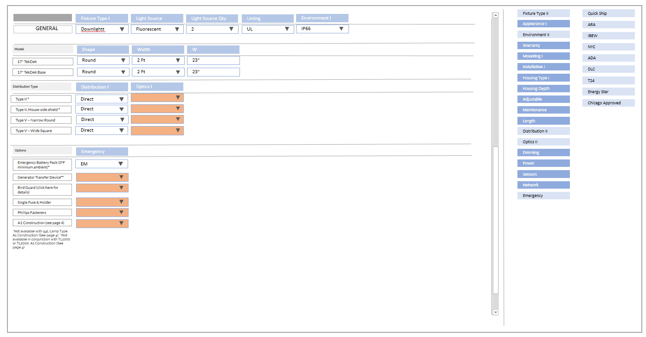
FAMILY
View
STATUS
In Progress
In Progress
Done
Done
MANUFACTURER. 23ED
Family*
SKU*
Database*
Correct
Incorrect
Discon
Updated
Image
Links
Data
Comments
Status on LightAZ
MNF
Change PDF, A linear pendant luminaire available in continuous lengths or individual
QA
Internal Comments
Questions to Manufacturer
3?
2.Is this available with cable?
Focal Point comment
Family
SKU
Data
Groups
SKU
Database
Drag & Drop
Database Fields

Slide 44
When click save, highlight boxes that does not have data in required fields
FAMILY
Auto add manufacturer Code in front of Family Group
Active
Featured
Family Code
Family Group
Family Name
Auto add manufacturer Code in front of Family Code (as it is now)
Family Code. Family short name
Auto add time when link is added
Manufacturer Page URL*
URL Date (auto)
Manufacturer Spec URL (or type X)*
PDF Date*
Disable entry if X typed in the Spec URL field
__/__/__
Paste Spec link or type X if manufacturer does not have link or have multiple PDF links

Slide 45
Save and update frontend & database
SAVE
FAMILY
STATUS
In progress
Done
Manufacturer
Missing link and picture
Family*
SKU*
Database*
Blank- (not selected)
Yellow – “In progress “
Green –”Ready”
Red –”Issue”
Product can be saved at any stage
Add time of saving and user for each.
Select manufacturer by typing in, or dropdown
(required fields)
External Status, initiated by either manufacturer, user or QA
Blank – when all blank
Yellow – “In progress” when one or more of 3 is not green.
Green –”Ok” when all others are green.
Red – “Issue” if marked by commenter. Hoover over to see comment from commenter

Slide 46
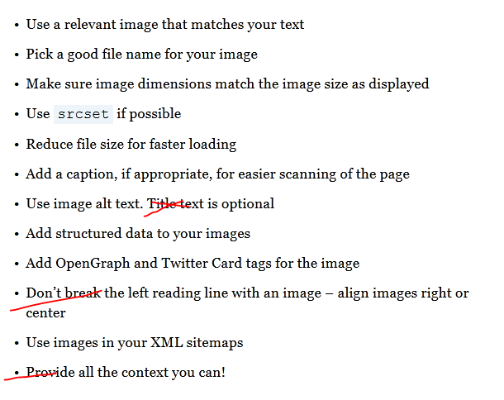
Copy and Paste image from websites or snapshots.
White & Black background choices, Zoom command , and Preset Frames 1: 800 x 500, 2: 800 x 800 3: 500 x 800
create thumbnail and first large image
Thumbnail:
-resize
-auto generate name:
“Manufacturer-Family name_01.jpg”
-auto generate alternative text
“Manufacturer. Family name”
3. Large images:
-auto generate name:
“Manufacturer-Family name_01.jpg”
“Manufacturer-Family name_02.jpg”
“Manufacturer-Family name_03.jpg”
-auto generate alternative text
“Manufacturer. Family name”
Thumbnail/First Image*
Image
Image
Image SEO

Slide 47
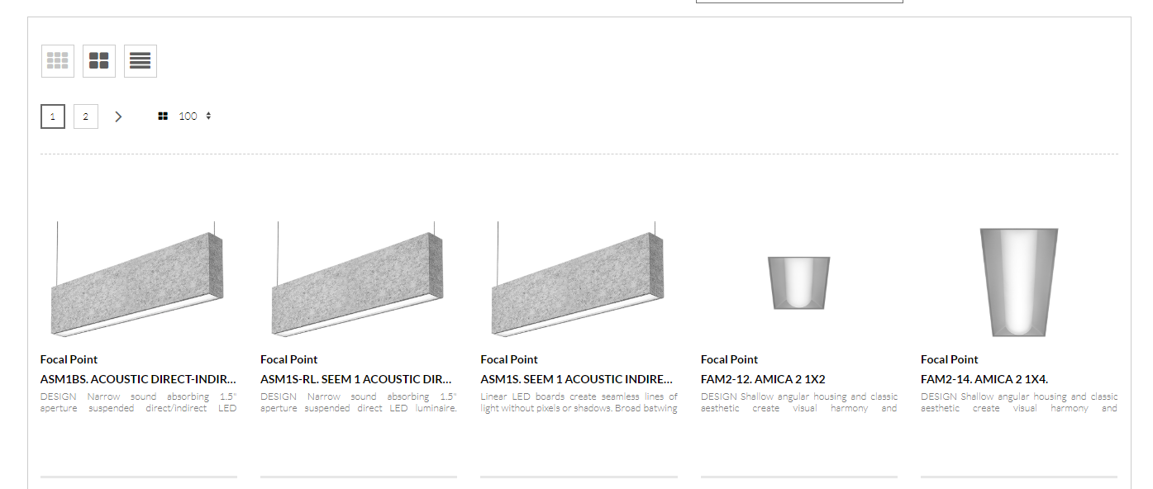
MNF DASHBOARD
Add New Product
Link to new product on your website
SUBMIT LINK
AND/OR
UPLOAD PDF
Comments (optional)
SAVE
MNF. dashboard
Sort By
ALL
New
Checked
Not Checked
Incorrect
Fixed
Questions
?
185
2
123
52
15
8
2
02/01/2019
?
02/01/2019
02/01/2019

Slide 48
MNF DASHBOARD
Add New Product
Link to new product on your website
SUBMIT LINK
AND/OR
UPLOAD PDF
Comments (optional)
Filtered by “new”
New
Checked
Not Checked
Incorrect
Fixed
Questions
Sort By
ALL
?
185
2
123
52
15
8
2
02/03/2019
?
02/01/2019
?
PDF

Slide 49
MNF DASHBOARD
Filtered by “incorrect”
ALL
New
Checked
Not Checked
Incorrect
Fixed
LightAZ ?
Sort By
?
185
2
123
52
15
8
2
Image
Page link
02/01/2019
Image
Page link
Data
10/02/2019

Slide 50
MNF DASHBOARD
Filtered by “fixed”
ALL
New
Checked
Not Checked
Incorrect
Fixed
LightAZ ?
Sort By
?
185
2
123
52
15
8
2
Image
Page link
02/01/2019
Image
Page link
Data
10/02/2019

Slide 51
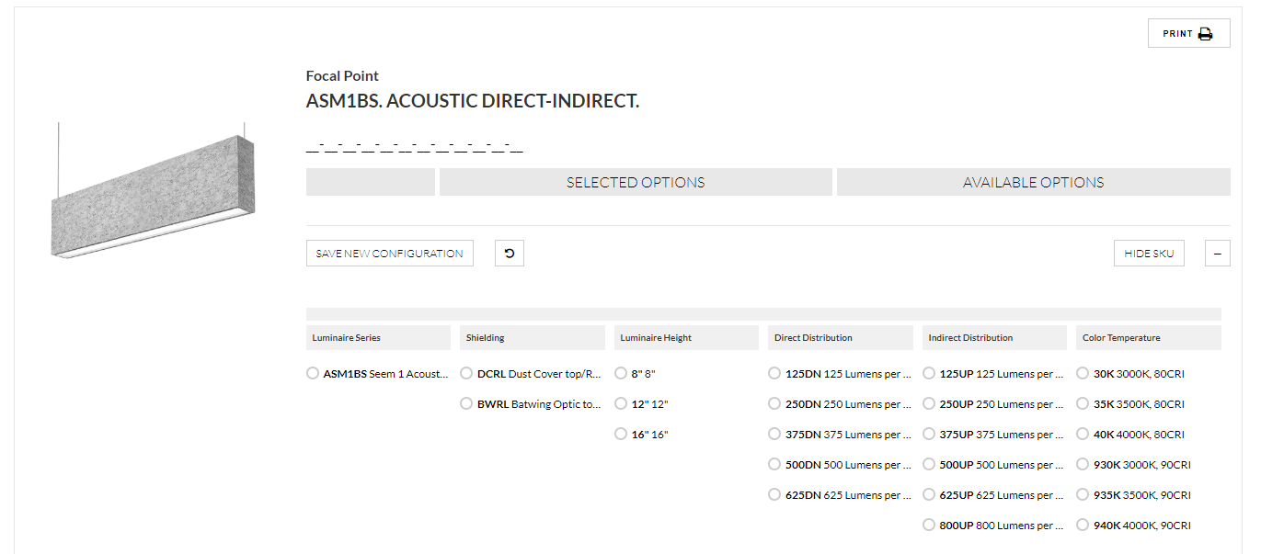
MNF DASHBOARD
Incorrect info, fixed. Family page
Manufacturers’ comments.
Please select category
Remove product from LightAZ until it fixed
Checked
Image
Spec Links
Page link
Data
Discon
Updated
Please change to other image.
2000 Lm should not be available with 30W
Link points to old spec
Focal Point
02/01/2019
SUBMIT

Slide 52
MNF DASHBOARD
Incorrect info, fixed. Family page
Manufacturers’ comments.
Please select category
Remove product from LightAZ until it fixed
Checked
Image
Spec Links
Page link
Data
Discon
Updated
Focal Point
02/01/2019
Please change to other image.
2000 Lm should not be available with 30W
Link points to old spec
SUBMITED

Slide 53
MNF DASHBOARD
Incorrect info, fixed. Family page
Manufacturers’ comments.
Please select category
Remove product from LightAZ until it fixed
Checked
Image
Spec Links
Page link
Data
Discon
Updated
Focal Point
02/01/2019
Please change to other image.
2000 Lm should not be available with 30W
Link points to old spec
LightAZ:
updated 02/10/2019
SUBMITED

Slide 54
MNF DASHBOARD
lightaz asking questions
Activate icon
Manufacturers’ comments.
Please select category
Checked
Incorrect
LightAZ ?
?
LightAZ: 02/01/2019
Should be 0-10V available with 120V?
Will it have pendant option?

Slide 55
MNF DASHBOARD
lightaz got answers
remove
Manufacturers’ comments.
Please select category
Checked
Incorrect
LightAZ: 02/01/2019
Should be 0-10V available with 120V?
Will it have pendant option?
Focal Point 02/03/2019
No
Yes

Slide 56
MNF DASHBOARD
Manufacturers’ comments.
Please select category
Correct
Incorrect
!
Comments

Slide 57
MNF DASHBOARD
When selected, activates options (next page)
Manufacturers’ comments.
Please select category
Correct
Incorrect
Comments

Slide 58
MNF DASHBOARD
Manufacturers’ comments.
Please select category
Remove product from LightAZ until it fixed
Correct
Image
Spec Links
Page link
Data
Discon
Updated
Comments

Slide 59
MNF DASHBOARD
Manufacturers’ comments.
Please select category
Remove product from LightAZ until it fixed
Image
Spec Links
Page link
Data
Discon
Updated
Comments

Slide 60
MNF DASHBOARD
Manufacturers’ comments.
Please select category
Remove product from LightAZ until it fixed
Image
Spec Links
Page link
Data
Discon
Updated
Comments

Slide 61
MNF DASHBOARD
Manufacturers’ comments.
Please select category
Remove product from LightAZ until it fixed
Image
Spec Links
Page link
Data
Discon
Updated
Comments

Slide 62
MNF DASHBOARD
When selected, expands
Manufacturers’ comments.
Please select category
Remove product from LightAZ until it fixed
Correct
Image
Spec Links
Page link
Data
Discon
Updated
Correct link
Comments

